Slide 1

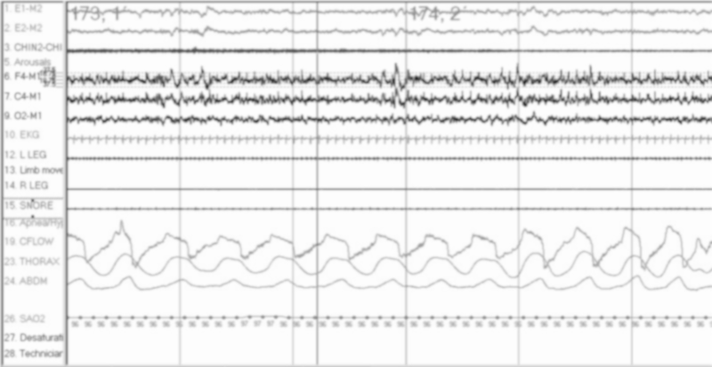
SEEK Q #315
Control of Ventilation and Sleep Disordered-Breathing for Pulm Fellows
Notes:
Changes to make: need to cover loop gain earlier
Only got to slide 21; chop after.
[ ] note: this has a good overview of the lay of the land for devices https://rc.rcjournal.com/content/57/6/921/tab-pdf

Slide 2
Control of Ventilation and Sleep Disordered-Breathing for Pulm Fellows
Brian Locke MD
Notes:
Good recent overview and synthesis here: https://onlinelibrary.wiley.com/doi/full/10.1002/alr.23079?casa_token=dhAPi6XTfPAAAAAA%3AziSV7MBZkUnyguOxVc2zNuWxexOaZE5OExdAE0DyCz8M4BJ0sRtLD1neWN3_wxayRDmHnqJwPof3rRs
Aims:
Get more seek questions right
Understand central apneas
(?variation in control of breathing by sleep stage?)
Understand RADs vs HMVs and their most common modes/uses
Know which patients should get tested for OSA.
Overall plan:
Review seek questions on the PSG /waveforms
Do seek question on the central apneas and explain pathogenesis
Explain different modes, and different devices [/DME qualification]
Then explore different indications for testing.

Slide 3
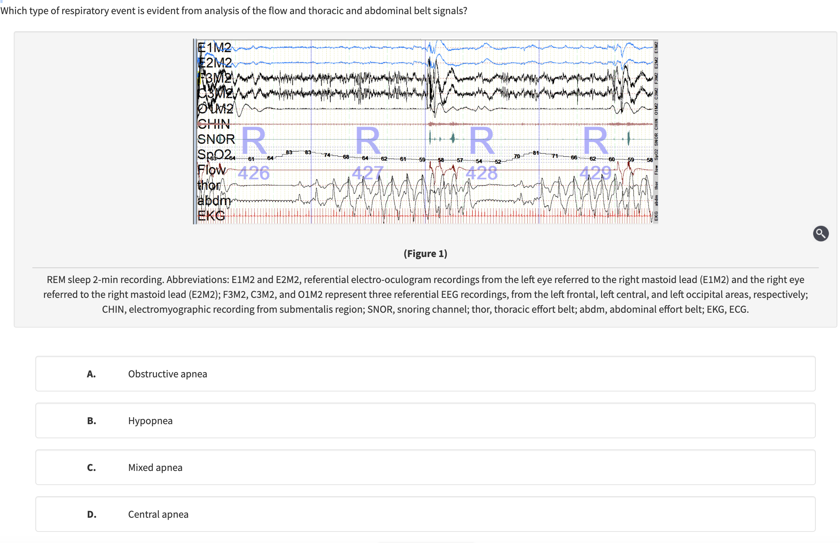
Notes:
A central apnea is characterized by complete cessation of airflow or 90% reduction in airflow with no respiratory effort throughout the entire duration of the apnea (choice D is incorrect). Figure 3 shows a 5-min recording during which five central apneas occur (the second central apnea is illustrated with a red box). A hypopnea is defined as 30% reduction in the flow signal that leads to 3% to 4% oxygen desaturation or cortical arousal with persistent respiratory effort on thoracic and abdominal belts (choice B is incorrect). An example of a hypopnea can be seen in Figure 4 in which the approximately 30% reduction in the nasal flow signal leads to 3% oxygen desaturation (shaded in green). An obstructive apnea is characterized by complete cessation of airflow or 90% reduction in airflow with continuous respiratory effort throughout the apnea (choice A is incorrect). An example of an obstructive apnea can be seen in Figure 4 (shaded in blue).

Slide 4
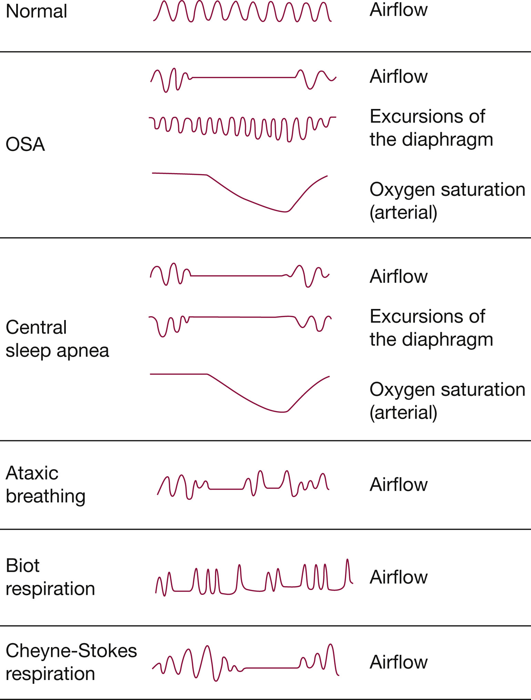

Slide 5
90+% reduction in airflow with no respiratory effort throughout
30+% reduction in airflow; 3-4% desat OR cortical arousal
90+% reduction in airflow with no respiratory effort throughout
Notes:
A central apnea is characterized by complete cessation of airflow or 90% reduction in airflow with no respiratory effort throughout the entire duration of the apnea (choice D is incorrect). Figure 3 shows a 5-min recording during which five central apneas occur (the second central apnea is illustrated with a red box). A hypopnea is defined as 30% reduction in the flow signal that leads to 3% to 4% oxygen desaturation or cortical arousal with persistent respiratory effort on thoracic and abdominal belts (choice B is incorrect). An example of a hypopnea can be seen in Figure 4 in which the approximately 30% reduction in the nasal flow signal leads to 3% oxygen desaturation (shaded in green). An obstructive apnea is characterized by complete cessation of airflow or 90% reduction in airflow with continuous respiratory effort throughout the apnea (choice A is incorrect). An example of an obstructive apnea can be seen in Figure 4 (shaded in blue).

Slide 6
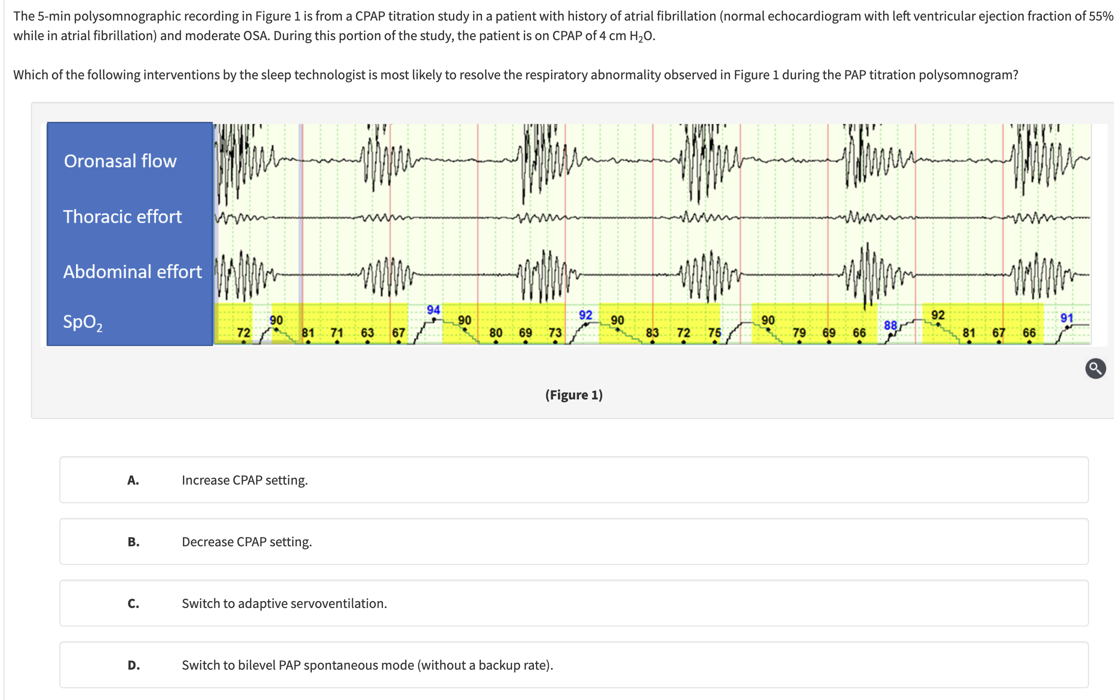
Notes:
In this patient with OSA and atrial fibrillation, CPAP titration led to treatment-emergent central sleep apnea (TECSA). This tracing reveals repetitive central apneas while on CPAP of 4 cm H₂O (no flow and no thoracic or abdominal effort). Since this patient has a normal ejection fraction on a recent echocardiogram, there is no contraindication for adaptive servoventilation (ASV) (choice C is correct). ASV is more effective in eliminating central apneas when compared with CPAP or bilevel PAP therapy. TECSA during CPAP titration can occur in 8% of patients with OSA. In many of these patients (50%-85%), central apneas resolve after 6 to 12 weeks of adherent home CPAP therapy. However, in some patients, central apneas can persist despite long-term CPAP therapy, particularly in patients who have other ongoing risk factors for central apneas (eg, atrial fibrillation, heart failure, opioid use). In these cases, ASV is effective in treating both OSA and central sleep apnea. On CPAP of 4 cm H₂O, this patient had resolution of OSA but developed severe central sleep apnea (ie, TECSA), with a central apnea index of 55 events per hour of sleep. As illustrated in Figure 2 (red box), apneas are characterized by lack of flow on the CPAP flow signal. The concomitant lack of effort on the thoracic and abdominal effort belts confirms the central nature of the apneas. ASV uses a bilevel PAP device that provides an expiratory PAP (EPAP) (which may be fixed or variable) and a variable level of inspiratory PAP (IPAP). The level of pressure support (difference between IPAP and EPAP) is variable, and the device is equipped with a feedback circuit that allows it to measure the respiratory output from the patient (from either peak inspiratory flow or minute ventilation). When the patient has excess respiratory effort or high minute ventilation, the device decreases the level of pressure support. In contrast, when the patient has reduced effort or low minute ventilation, the device increases the level of pressure support. A preset or automatic backup rate delivers breaths during periods of central apnea. The goal of ASV is to resolve upper airway obstruction and OSA with EPAP and regularize the breathing pattern and induce a mild level of hypoventilation in patients with central sleep apnea related to hyperventilation. ASV should not be used in patients with hypoventilation syndromes. If the patient had a low left ventricular ejection fraction (less than 45%), ASV would be contraindicated. Currently, there are no effective PAP treatments for central sleep apnea and Cheyne-Stokes respiration in patients with heart failure with reduced ejection fraction (HFrEF). In the Canadian Continuous Positive Airway Pressure for Patients with Central Sleep Apnea and Heart Failure (CANPAP) trial, patients with HFrEF and central sleep apnea were randomized to CPAP or usual care. CPAP did not improve survival when compared with usual care. Although ASV during sleep is highly effective in abolishing central sleep apnea, it has been associated with increased all-cause and cardiovascular mortality in this patient population, particularly in those with a left ventricular ejection fraction less than 35%. The exact mechanism for the increased mortality is not fully understood.
It is unlikely that a higher CPAP setting will improve central apneas (choice A is incorrect). CPAP setting of 4 cm H₂O is the lowest pressure in commercially available CPAP devices (choice B is incorrect). Switching the patient to bilevel PAP without a backup rate will increase tidal volumes, worsen respiratory instability, and increase central apneas (choice D is incorrect). Bilevel PAP with a backup respiratory rate (bilevel PAP spontaneous timed) could be considered in lieu of ASV.

Slide 7
Central Apneas (Periodic Breathing)
Developed after OSA treatment = TECSA
Or, could wait and do nothing; or give oxygen
Notes:
In this patient with OSA and atrial fibrillation, CPAP titration led to treatment-emergent central sleep apnea (TECSA). This tracing reveals repetitive central apneas while on CPAP of 4 cm H₂O (no flow and no thoracic or abdominal effort). Since this patient has a normal ejection fraction on a recent echocardiogram, there is no contraindication for adaptive servoventilation (ASV) (choice C is correct). ASV is more effective in eliminating central apneas when compared with CPAP or bilevel PAP therapy. TECSA during CPAP titration can occur in 8% of patients with OSA. In many of these patients (50%-85%), central apneas resolve after 6 to 12 weeks of adherent home CPAP therapy. However, in some patients, central apneas can persist despite long-term CPAP therapy, particularly in patients who have other ongoing risk factors for central apneas (eg, atrial fibrillation, heart failure, opioid use). In these cases, ASV is effective in treating both OSA and central sleep apnea. On CPAP of 4 cm H₂O, this patient had resolution of OSA but developed severe central sleep apnea (ie, TECSA), with a central apnea index of 55 events per hour of sleep. As illustrated in Figure 2 (red box), apneas are characterized by lack of flow on the CPAP flow signal. The concomitant lack of effort on the thoracic and abdominal effort belts confirms the central nature of the apneas. ASV uses a bilevel PAP device that provides an expiratory PAP (EPAP) (which may be fixed or variable) and a variable level of inspiratory PAP (IPAP). The level of pressure support (difference between IPAP and EPAP) is variable, and the device is equipped with a feedback circuit that allows it to measure the respiratory output from the patient (from either peak inspiratory flow or minute ventilation). When the patient has excess respiratory effort or high minute ventilation, the device decreases the level of pressure support. In contrast, when the patient has reduced effort or low minute ventilation, the device increases the level of pressure support. A preset or automatic backup rate delivers breaths during periods of central apnea. The goal of ASV is to resolve upper airway obstruction and OSA with EPAP and regularize the breathing pattern and induce a mild level of hypoventilation in patients with central sleep apnea related to hyperventilation. ASV should not be used in patients with hypoventilation syndromes. If the patient had a low left ventricular ejection fraction (less than 45%), ASV would be contraindicated. Currently, there are no effective PAP treatments for central sleep apnea and Cheyne-Stokes respiration in patients with heart failure with reduced ejection fraction (HFrEF). In the Canadian Continuous Positive Airway Pressure for Patients with Central Sleep Apnea and Heart Failure (CANPAP) trial, patients with HFrEF and central sleep apnea were randomized to CPAP or usual care. CPAP did not improve survival when compared with usual care. Although ASV during sleep is highly effective in abolishing central sleep apnea, it has been associated with increased all-cause and cardiovascular mortality in this patient population, particularly in those with a left ventricular ejection fraction less than 35%. The exact mechanism for the increased mortality is not fully understood.
It is unlikely that a higher CPAP setting will improve central apneas (choice A is incorrect). CPAP setting of 4 cm H₂O is the lowest pressure in commercially available CPAP devices (choice B is incorrect). Switching the patient to bilevel PAP without a backup rate will increase tidal volumes, worsen respiratory instability, and increase central apneas (choice D is incorrect). Bilevel PAP with a backup respiratory rate (bilevel PAP spontaneous timed) could be considered in lieu of ASV.

Slide 8
Central Apneas
Many causes ; high loop gain or low CO2 reserve
Respiratory Generator Impaired; Opiates
Respiratory Generator Impaired; Stroke, ICP, Herniation
Hunter-Cheyne Stokes Respiration or Elevation depending on period length; high loop gain or low CO2 reserve

Slide 9
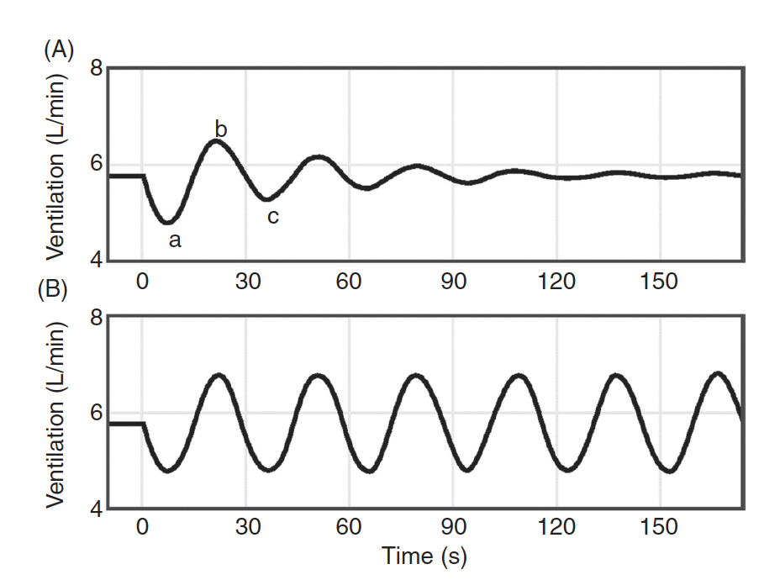
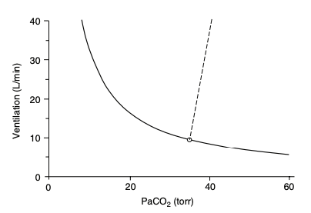
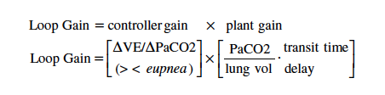
Central Apneas
High Loop Gain | Narrow CO2 Reserve

Slide 10
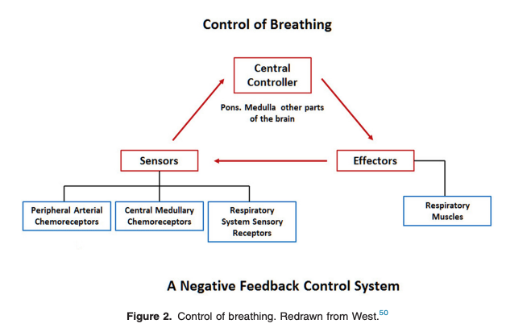
Control of Respiration
Chemoreflex –
Central: CSF pH, correlates to blood CO2 (slow, increases 45+)
Peripheral: CO2>41, O2 < 55, pH low. Fast.
Voluntary / supratentorial: rib movement censors
Metabolic drive – mediated by unknown mechanisms (e.g. how the Ve increases in CPET before blood gases change)
Wakefulness drive – disappears during sleep, such that a minor PaCO2 drop in the presence of normoxia produces a central apnea during sleep or anesthesia
Notes:
When CO2 and pH diverge? E.g. metabolic acidosis (DKA) does generate increased ventilation – but it is mediated at the PERIPHERAL receptors (pH sensors) not central (CO2 sensor, except in extreme acidosis where BBB becomes slightly more permeable)
Aortic bodies can sense CaO2 in addition to PaO2 – this mediates some of the physiologic responses to anemia and CO poisononing, though exact mechanisms not entirely understood.
The ventilatory response to PaO2 is hyperbolic, being almost flat in the high PaO2 range and the slope increases progressively as PaO2 decreases (313)
Threshold where it starts to increase = ~60
Below that threshold, there is a syndergistic response with CO2 (ie. low PaO2 and high PaCO2 -> larger ventilatory response)
HCVR varies significantly (up to ten fold), but it is more due to circumstance than it is due to inheretence per se. Javaheri S, Colangelo G, Corser B et al. Familial respiratory chemosensitivity does not predict hypercapnia of patients with sleep apnea-hypopnea syndrome. Am. Rev. Respir. Dis. 1992; 145: 837–40.
Plasticity occurs in several circumstances: e.g. hypoxemia will lead to an increase in O2 sensitivity at peripheral chemoreceptors that persists for several days after normoxia is restored.
Long term facilitation occurs after intermittent hypoxemia -> carotid sensitization -> sustained adrenergic activity (may be responsible for some of the daytime changes seen in obstructive sleep apnea)

Slide 11
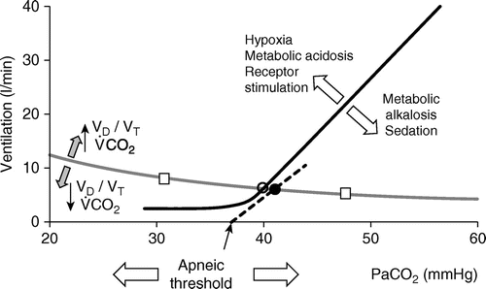
Ventilation during sleep
Wakefulness drive to breath = a stimulus to keep breathing at some Ve even when the CO2 is below the apneic threshold (the flat part of the hockey stick)
Defined in absence… the hockey stick (a maintained low level of ventilation) goes away when you go to sleep.
Apneic threshold = PaCO2 below which breathing stops during sleep.
~33-35 mmHg at sea level; goes up faster than PaCO2 with hypercapnia
PaCO2 to terminate an apnea ~1-4 CO2 higher than PaCO2 to start an apnea
Difference between PaCO2 baseline and Apneic threshold = called the CO2 reserve)

Slide 12
Synthesis:
You want to induce apneas in someone, what mode would you set them in?
Why does oxygen reduce central apneas?
What happens if you send someone with new diagnosed OHS home with BPAP and no back-up?
Notes:
An early study by Parthasarathy and Tobin concluded that patients receiving high-level pressure support ventilation (PSV) without a backup rate (average pressure support of 16.8 cmH20) compared to assist control ventilation (ACV) settings had significant central sleep apneas resulting in sleep fragmentation (92). They found a 23 and 30% increase in inspiratory and expiratory time, respectively, along with a 33% decrease in respiratory rate on PSV. The increased inspiratory time led to an increase in tidal volume during sleep and resultant hypocapnia below the apnea threshold (93). It is likely that the set pressure support was greater than necessary given the decrease in oxygen consumption and carbon dioxide (CO₂) production during sleep, which results in decreased minute ventilation
One other study conducted by Cabello and colleagues documented central sleep apneas in PSV compared to ACV. They noted central apneas in 9 of 15 patients receiving either physician adjusted PSV or automatically adjusted PSV, but observed a similar level of sleep fragmentation and arousals compared to ACV. Less than 10% of sleep fragmentation was therefore attributed to the CSA events.
https://www.frontiersin.org/articles/10.3389/fmed.2023.1199685/full#ref83

Slide 13
If these issues are so common, why don’t we see apneas all over the place inpatient?
1. Pulse oximetry averages waveforms over 10 seconds
“HRPO” = noc ox; average over 2 seconds for inpatient sleep
2. All BPAP inpatient is BPAP S/T – always backup rates preventing apneas.

Slide 14
Stage | Mechanics (Loads on the respiratory system) | Muscle Activity | Chemoresponsiveness | PaCO2
Awake | Upright-ish; open airway | Ok | Normal | CO2 stable across a huge range of VCO2 (30x in health)
NREM (1-3) | Supine (decreased FRC -> EELV), decreased UA tone = increased resistance to flow | Ok | Reduced | Slight increases in PaCO2 (Decreased VCO2, but more decreased VE)
REM | Supine (decreased FRC -> EELV), decreased UA tone = increased resistance to flow | Non-diaphragm muscles are paralyzed* | Very reduced | Normal: increases up to 6 mmHg of CO2; pathologic 10+ (=sleep hypoventilation)
When will obstructive apneas be the worst?
When will central apneas be the worth?
When will sleep hypoventilation be the worst, and in whom?
Notes:
In COPD Becker et al. (28) showed that average decrease
in minute ventilation from wakefulness to NREM sleep was
16%, with a 32% fall in REM compared to awake values
Citation for this - https://academic.oup.com/sleep/article/41/5/zsy040/4944421 - specifically discusses loop gain.

Slide 15
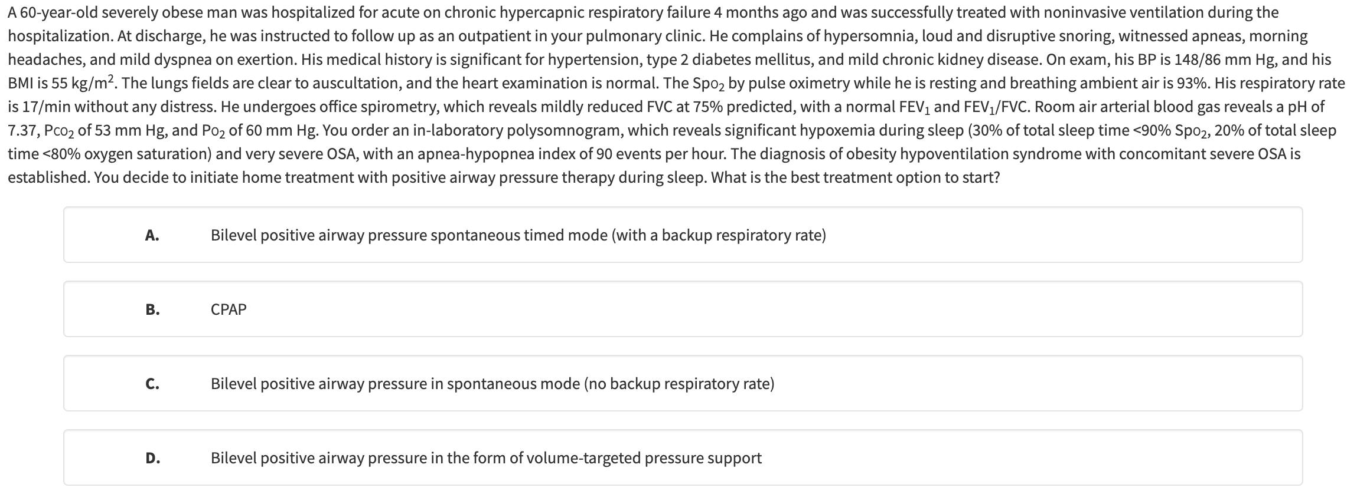
Notes:
Greater than 30 AHI = CPAP just as effective, but faster, easier, cheaper.
If < 50? BPAP S/T
If immediately after hospitalization?

Slide 16
Greater than 30 AHI = CPAP just as effective, but faster, easier, cheaper.
70% of patients with OHS have AHI > 30
Notes:
Greater than 30 AHI = CPAP just as effective, but faster, easier, cheaper.
If < 50? BPAP S/T
If immediately after hospitalization?

Slide 17
Same question; but just diagnosed and on hospital discharge:
What do you prescribe?
VAPS-AE
BPAP-S
BPAP-ST
Nothing; sleep clinic referral

Slide 18

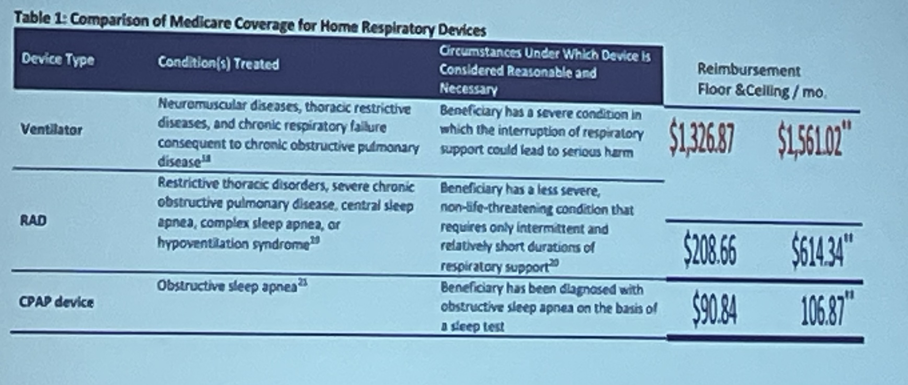
Same question; but just diagnosed and on hospital discharge:
What do you prescribe?
VAPS-AE
BPAP-S
BPAP-ST
Nothing; sleep clinic referral

Slide 19
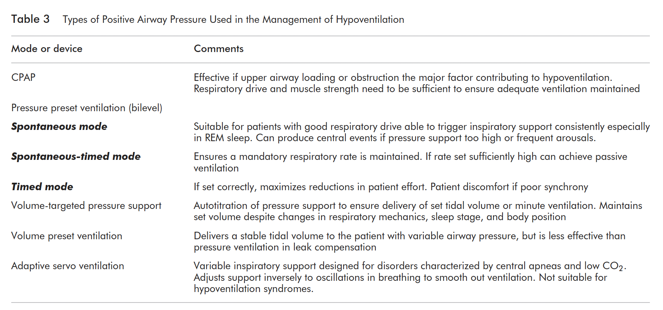
OSA, some OHS
some OHS
IVAPS (Resmed) vs
AVAPs (Respironics)
CSA
Notes:
S mode = all patient efforts
ST mode = backup rate
PC mode = adds that inspiratory time guaranteed
VAPS = pressure changes (inspiratory time doesn’t) to hit target.
(Resmed = adjust Ti min)
VAPS modes:
AVAPS: targets tidal volume
modes: s, st, pc, ae
AE: ST mode with variable EPAP. True AVAPS-AE is only ventilator (not RADs).
IVAPS: targets minute ventilation.
Titration goal:
Obstruction = EPAP level
Improve gas exchange = spo2 and CO2 based on TcCo2 (at our elevation, our we able to do this with just SpO2? definitely not at sea level)
Decreased WOB: TV increase, RR, and EMG activity.
Note: all of these titration algorithms will be off with significant mask leak.
Nasal CPAP pushes the soft palate against the tongue - can be used in mouth breathing.
***Ann ATS guideline.
When to add supplemental oxygen?
Awake SpO2 88% (Medicare)
Or, persistent hypoxemia after ventilation optimize.
Keep in mind that leaks will decrease the delivered FiO2

Slide 20
RADs vs HMV
Respiratory Assist Device | Home Mechanical Ventilator
S / ST/ VAPS / PC modes | Required if you want AVAPS-AE Titrates EPAP in addition to PS
(E0470 or E0471 are the DME codes) | Mouthpiece ventilation; High Flow O2, IPAP 30+
Sufficient for most patients; but difficult insurance requirements (next slide) | In patients who’s ventilatory needs are likely to be more complex over time (e.g. NMD) Or a patient who MUST have on discharge
 | Comes with RT support from the DME
Rent to own; less expensive | $$$ (just rent; never own)
 | Battery Powered
Notes:
Acute on chronic respiratory failure (e.g., neuromuscular disease, COPD, obesity hypoventilation, other respiratory failure / hypoventilation conditions)
Requiring ongoing noninvasive ventilatory support but otherwise stable for discharge (nocturnal or full-time)
Requires modes "not available on RAD* Discharge is unsafe without NIV continuation -> high risk of readmission, ED visits, death

Slide 21
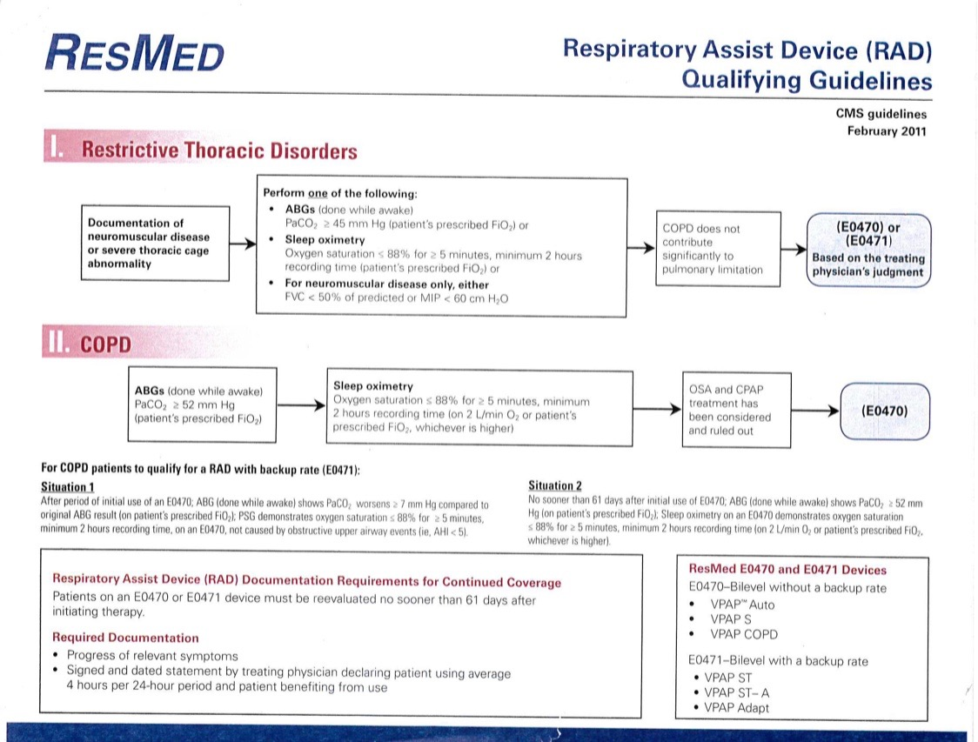
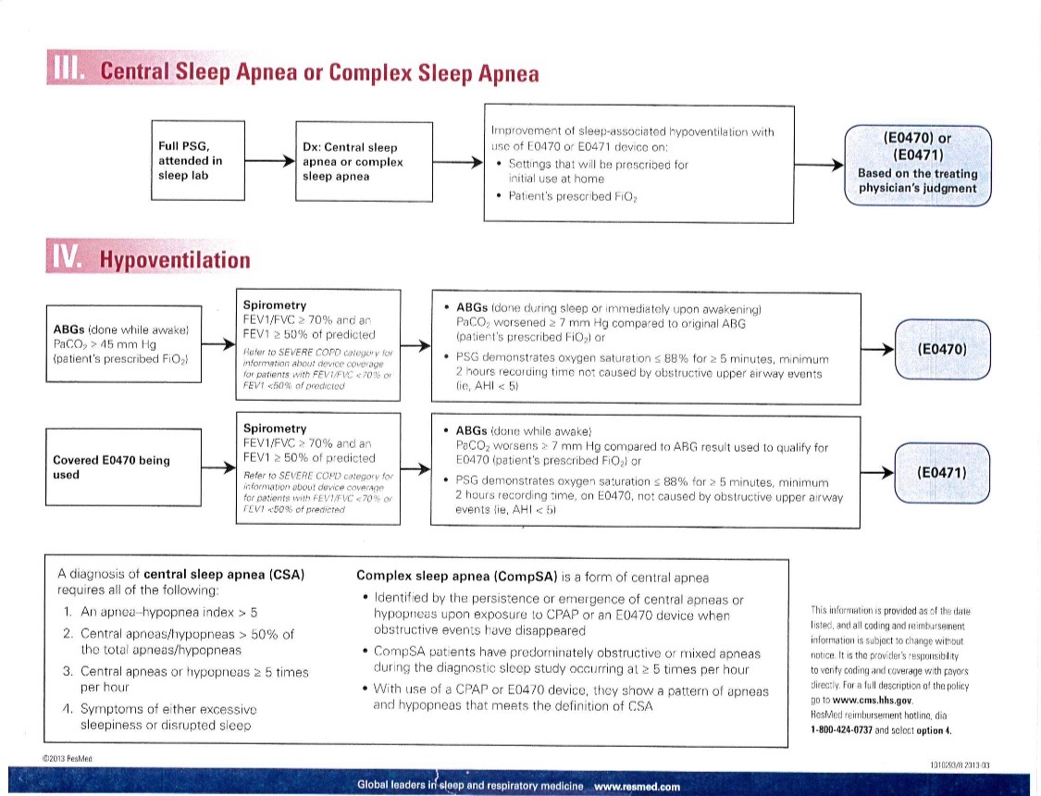
Qualification for RADs
Notes:
Reasons to get an HMV:
VAPS with auto EPAPp
Daytime batter
Mouthpiece
Pressures over 30
Also, gets you home RT.. But this is very expensive for the patient.
RAD -> difficult to obtain with current insurance determination
HMV ->

Slide 22
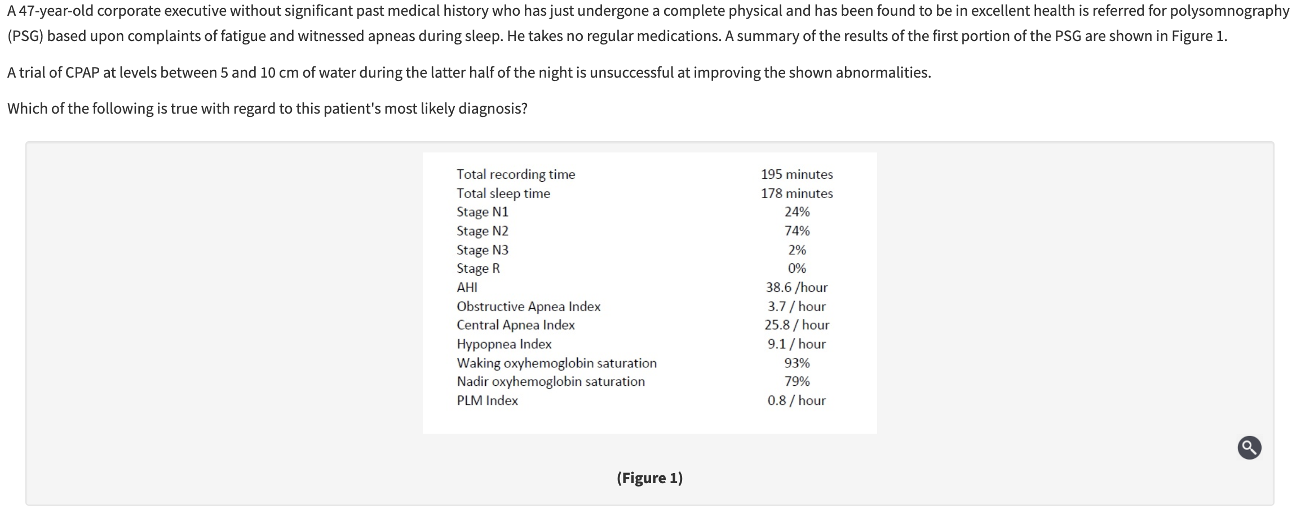
The disorder is likely to worsen during REM sleep.
Bilevel pressure, spontaneous mode, is an effective therapy.
The use of low-dose hypnotics is likely to exacerbate disease.
The addition of supplemental oxygen during sleep may decrease the frequency of events.
Notes:
The PSG findings are diagnostic of central sleep apnea (CSA); this can be a primary or secondary condition. Secondary causes include Cheyne-Stokes breathing (usually related to congestive heart failure or stroke), high altitude, and sedative-hypnotic use. In the absence of any of these abnormalities, the patient likely has primary (or idiopathic) CSA. This diagnosis requires PSG demonstrating a central event index of at least five per hour, in the absence of a Cheyne-Stokes breathing pattern, diurnal hypoventilation or another explanation for the findings (an alternate sleep pathology, medical disorder, or causal pharmacologic agent). This disorder is most often diagnosed in the middle-aged or elderly, and seems to be more common in men than women. Events are caused by a decrease in arterial CO₂ levels below the apneic threshold during sleep, and is often associated with an elevated loop gain (a high ventilatory response to changes in CO₂ levels). Because ventilatory control is more unstable during transitions into sleep, primary CSA is often seen more commonly in patients with frequent arousals. Affected patients may have an abnormally low CO₂ level during the day, though this is unlikely to induce apnea during periods of wakefulness.
While CPAP is the preferred treatment for patients with CSA, most of the data for the use of this therapy comes from patients with CSA secondary to cardiac disease. It is thought to work in this population by minimizing airway narrowing during central apneas; such airway narrowing can lead to a greater negative airway pressure when breathing resumes, which can lead to ventilatory overshoot, subsequent hypocapnia, and repeated central events.
When CPAP fails to provide benefit, there are several other options that should be considered. Supplemental oxygen during sleep is a reasonable next step; it can be used on its own or as an adjunct to CPAP. Not only has this therapy been shown to decrease the degree of nocturnal hypoxemia, but it may also be associated with improvements in apnea hypopnea index (AHI) (choice D is correct). The mechanism for this improvement has not been elucidated, though some have theorized that it may be due to a decrease in CO₂ chemosensitivity.
For patients with a normal ejection fraction, adaptive servo ventilation (ASV) can be considered, though this therapy is contraindicated in patients with an impaired ejection fraction (≤45%) based on the SERVE-HF randomized trial. ASV delivers a fixed level of expiratory pressure and a variable amount of pressure support during inspiration, as well as a backup respiratory rate.
Bilevel positive airway pressure (BPAP) can be an effective treatment for CSA when used in the spontaneous-timed (ST) mode, although it is typically used after both CPAP and oxygen therapy has failed. Unlike ASV, BPAP typically offers a fixed degree of inspiratory pressure support and thus can minimize hypopnea events. However, when used in the spontaneous mode without a backup rate, it will not ventilate the patient during periods of central apnea; indeed, the hyperventilation induced by a larger pressure support may actually exacerbate the frequency and duration of central apnea events. Therefore, BPAP should not be used without a backup rate in this population (choice B is incorrect).
Because the ventilatory response to CO₂ is lower during REM sleep, primary CSA is usually significantly attenuated during REM (choice A is incorrect). In addition, because central events are more common during transitions into and out of sleep, low-dose sedative-hypnotic agents have been evaluated for primary CSA, and have been shown to reduce disease severity (choice C is incorrect), though there are no formal recommendations for use of this therapy at this time due to the relative paucity of data.

Slide 23
The disorder is likely to worsen during REM sleep.
Bilevel pressure, spontaneous mode, is an effective therapy.
The use of low-dose hypnotics is likely to exacerbate disease.
The addition of supplemental oxygen during sleep may decrease the frequency of events.
Notes:
The PSG findings are diagnostic of central sleep apnea (CSA); this can be a primary or secondary condition. Secondary causes include Cheyne-Stokes breathing (usually related to congestive heart failure or stroke), high altitude, and sedative-hypnotic use. In the absence of any of these abnormalities, the patient likely has primary (or idiopathic) CSA. This diagnosis requires PSG demonstrating a central event index of at least five per hour, in the absence of a Cheyne-Stokes breathing pattern, diurnal hypoventilation or another explanation for the findings (an alternate sleep pathology, medical disorder, or causal pharmacologic agent). This disorder is most often diagnosed in the middle-aged or elderly, and seems to be more common in men than women. Events are caused by a decrease in arterial CO₂ levels below the apneic threshold during sleep, and is often associated with an elevated loop gain (a high ventilatory response to changes in CO₂ levels). Because ventilatory control is more unstable during transitions into sleep, primary CSA is often seen more commonly in patients with frequent arousals. Affected patients may have an abnormally low CO₂ level during the day, though this is unlikely to induce apnea during periods of wakefulness.
While CPAP is the preferred treatment for patients with CSA, most of the data for the use of this therapy comes from patients with CSA secondary to cardiac disease. It is thought to work in this population by minimizing airway narrowing during central apneas; such airway narrowing can lead to a greater negative airway pressure when breathing resumes, which can lead to ventilatory overshoot, subsequent hypocapnia, and repeated central events.
When CPAP fails to provide benefit, there are several other options that should be considered. Supplemental oxygen during sleep is a reasonable next step; it can be used on its own or as an adjunct to CPAP. Not only has this therapy been shown to decrease the degree of nocturnal hypoxemia, but it may also be associated with improvements in apnea hypopnea index (AHI) (choice D is correct). The mechanism for this improvement has not been elucidated, though some have theorized that it may be due to a decrease in CO₂ chemosensitivity.
For patients with a normal ejection fraction, adaptive servo ventilation (ASV) can be considered, though this therapy is contraindicated in patients with an impaired ejection fraction (≤45%) based on the SERVE-HF randomized trial. ASV delivers a fixed level of expiratory pressure and a variable amount of pressure support during inspiration, as well as a backup respiratory rate.
Bilevel positive airway pressure (BPAP) can be an effective treatment for CSA when used in the spontaneous-timed (ST) mode, although it is typically used after both CPAP and oxygen therapy has failed. Unlike ASV, BPAP typically offers a fixed degree of inspiratory pressure support and thus can minimize hypopnea events. However, when used in the spontaneous mode without a backup rate, it will not ventilate the patient during periods of central apnea; indeed, the hyperventilation induced by a larger pressure support may actually exacerbate the frequency and duration of central apnea events. Therefore, BPAP should not be used without a backup rate in this population (choice B is incorrect).
Because the ventilatory response to CO₂ is lower during REM sleep, primary CSA is usually significantly attenuated during REM (choice A is incorrect). In addition, because central events are more common during transitions into and out of sleep, low-dose sedative-hypnotic agents have been evaluated for primary CSA, and have been shown to reduce disease severity (choice C is incorrect), though there are no formal recommendations for use of this therapy at this time due to the relative paucity of data.

Slide 24
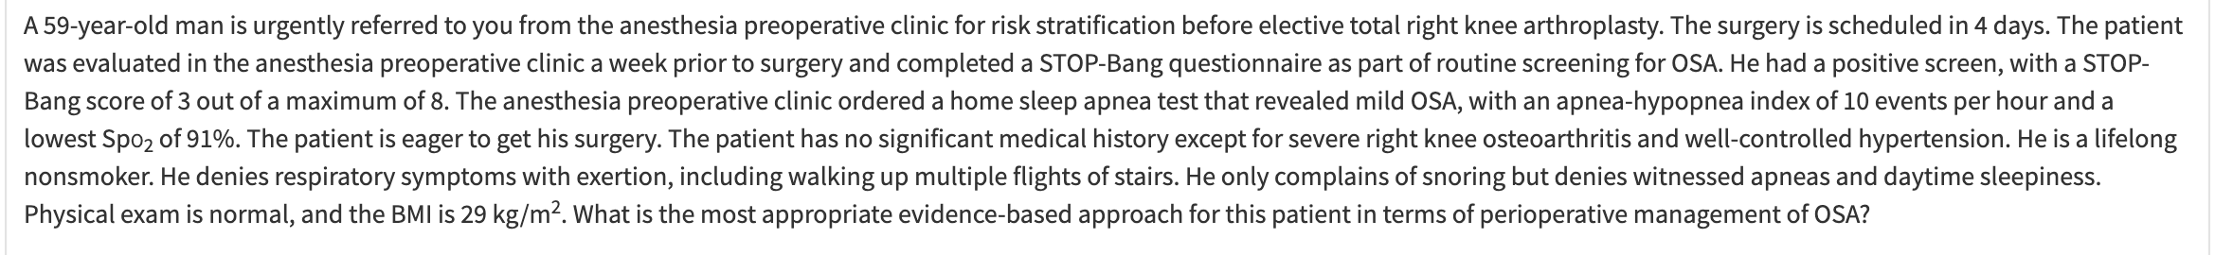
Notes:
D Proceed with surgery
A large prospective, observational study reported that among at-risk adults undergoing major noncardiac surgery, unrecognized severe OSA was significantly associated with increased risk of 30-day postoperative cardiovascular complications. In this study, high risk was defined as the presence or history of any of the following medical conditions: coronary artery disease, heart failure, stroke or transient ischemic attack, diabetes requiring treatment, or renal impairment. Importantly, even in this "at-risk" group of adults, mild OSA was not associated with worse postoperative outcomes (choice C is incorrect). Therefore, there is no need for a higher level of monitoring during the postoperative period (choice B is incorrect). Even though there are no published randomized clinical trials assessing the impact of perioperative CPAP in patients with OSA, it may be prudent to initiate perioperative CPAP in patients with severe OSA, particularly in those who exhibit significant hypoxemia during the sleep study. It is important to point out that no specific level of sleep hypoxemia has been studied; therefore, clinical judgment is required. Retrospective studies have shown that patients suspected of having obesity-related hypoventilation have increased risk of perioperative cardiopulmonary complications. Delaying elective surgery in such patients is prudent in order to perform a sleep study and initiate home positive airway pressure therapy and to ensure adequate adherence to positive airway pressure therapy. The appropriate level of postoperative monitoring in these patients has not been well established; therefore, clinical judgment is required

Slide 25
Just send to surgery.
Mild OSA is not associated with much of anything, except marginally increased improvement after CPAP
(probably only severe & OHS for increased perioperative risk)
Notes:
D Proceed with surgery
A large prospective, observational study reported that among at-risk adults undergoing major noncardiac surgery, unrecognized severe OSA was significantly associated with increased risk of 30-day postoperative cardiovascular complications. In this study, high risk was defined as the presence or history of any of the following medical conditions: coronary artery disease, heart failure, stroke or transient ischemic attack, diabetes requiring treatment, or renal impairment. Importantly, even in this "at-risk" group of adults, mild OSA was not associated with worse postoperative outcomes (choice C is incorrect). Therefore, there is no need for a higher level of monitoring during the postoperative period (choice B is incorrect). Even though there are no published randomized clinical trials assessing the impact of perioperative CPAP in patients with OSA, it may be prudent to initiate perioperative CPAP in patients with severe OSA, particularly in those who exhibit significant hypoxemia during the sleep study. It is important to point out that no specific level of sleep hypoxemia has been studied; therefore, clinical judgment is required. Retrospective studies have shown that patients suspected of having obesity-related hypoventilation have increased risk of perioperative cardiopulmonary complications. Delaying elective surgery in such patients is prudent in order to perform a sleep study and initiate home positive airway pressure therapy and to ensure adequate adherence to positive airway pressure therapy. The appropriate level of postoperative monitoring in these patients has not been well established; therefore, clinical judgment is required

Slide 27
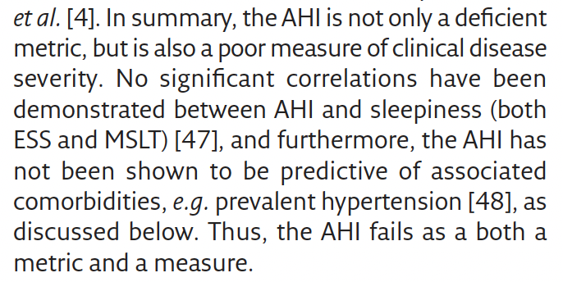
The definition of OSA is bad
OSA, as currently defined, is improbably common.
The definition does not discriminate well between people suffering adverse consequences and those who don’t.
AHI does not really represent what we care about
Just frequency of events; not duration, their impact, etc.
Why is 5(+sx) or 15 the cutoff?
NOT 95% range in healthy individuals as usual
Associated with increased risk of stroke at 15/hr in large cohorts
Prevalence of excess sleepiness in Prim Care? 1 in 4
Just because they ”have OSA” doesn’t mean they have OSA
Alternatives to AHI?
there are many, not ready for primetime
Notes:
Historical:
Initially, tabulated # of events -> tried to find best way to count. (Adding hypopnea, 30 vs 50% flow reduction, etc.)
This is a surrogate for the ventilatory abnormality of interest
That ventilatory burden is itself just a risk factor for the adverse effects of disease.
Metrics of sleep apnea severity: beyond the AHI article summarizes this.
Ways to improve (prediction of consequences, prediction of therapy) :
Refine thresholds
Only count events with consequences.
Hypoxic burden, arousal burden (though these are still contingent on events) - summarizes consequences
PUP - trying to impute the underlying precision. [ ] what is this?

Slide 28
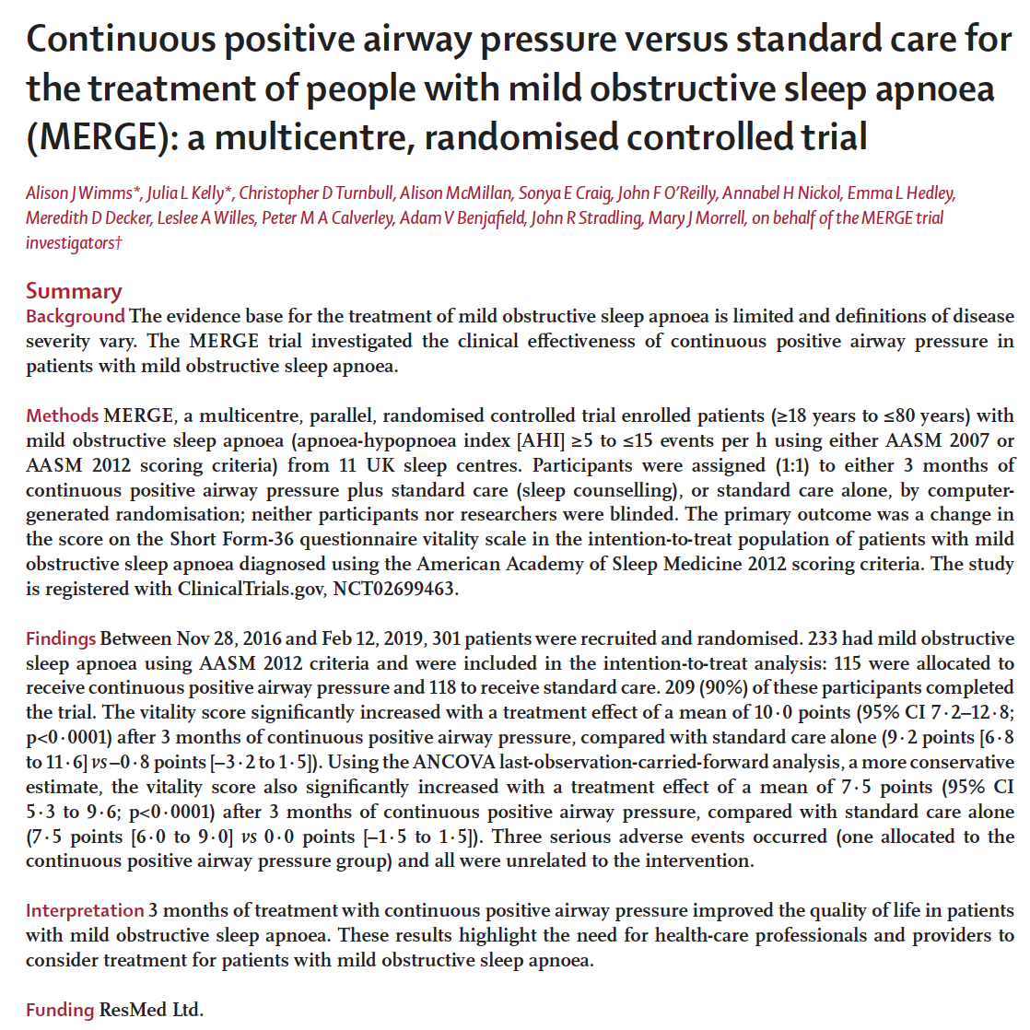
Notes:
More people do respond (sleepiness) to treatment than would be expected if it was all bullshit

Slide 29
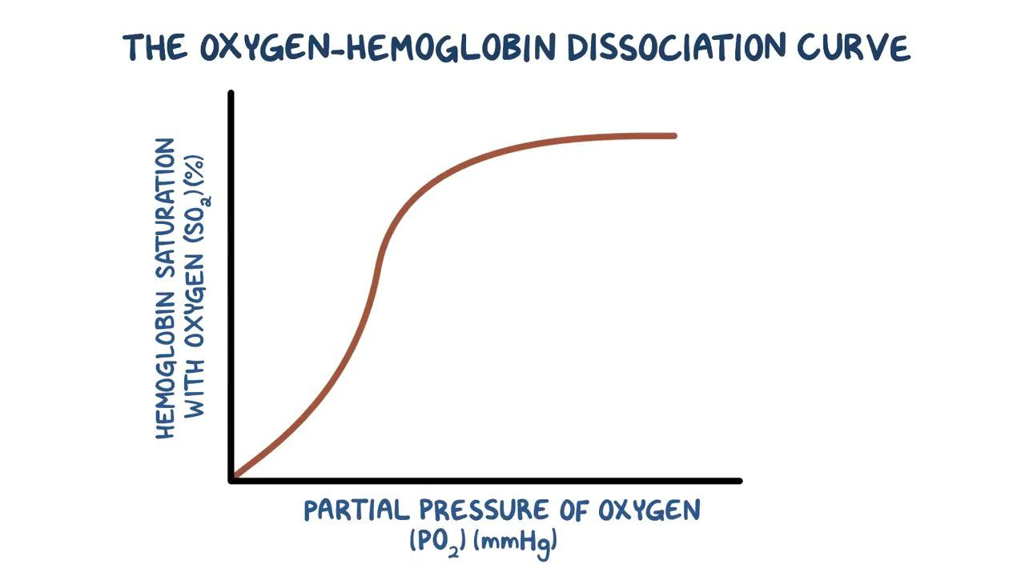
The definition of a hypopnea in UT
Big event required at sea level for 3-4% oxygen desaturation
Sea-level
Utah
Small event required at elevation level for 3-4% oxygen desaturation
“Prevalence” in UT, by accepted definitions, would be absurdly high.
If you look, you will find it
You can’t use the presence of ”disease” as an indication for treatment

Slide 30
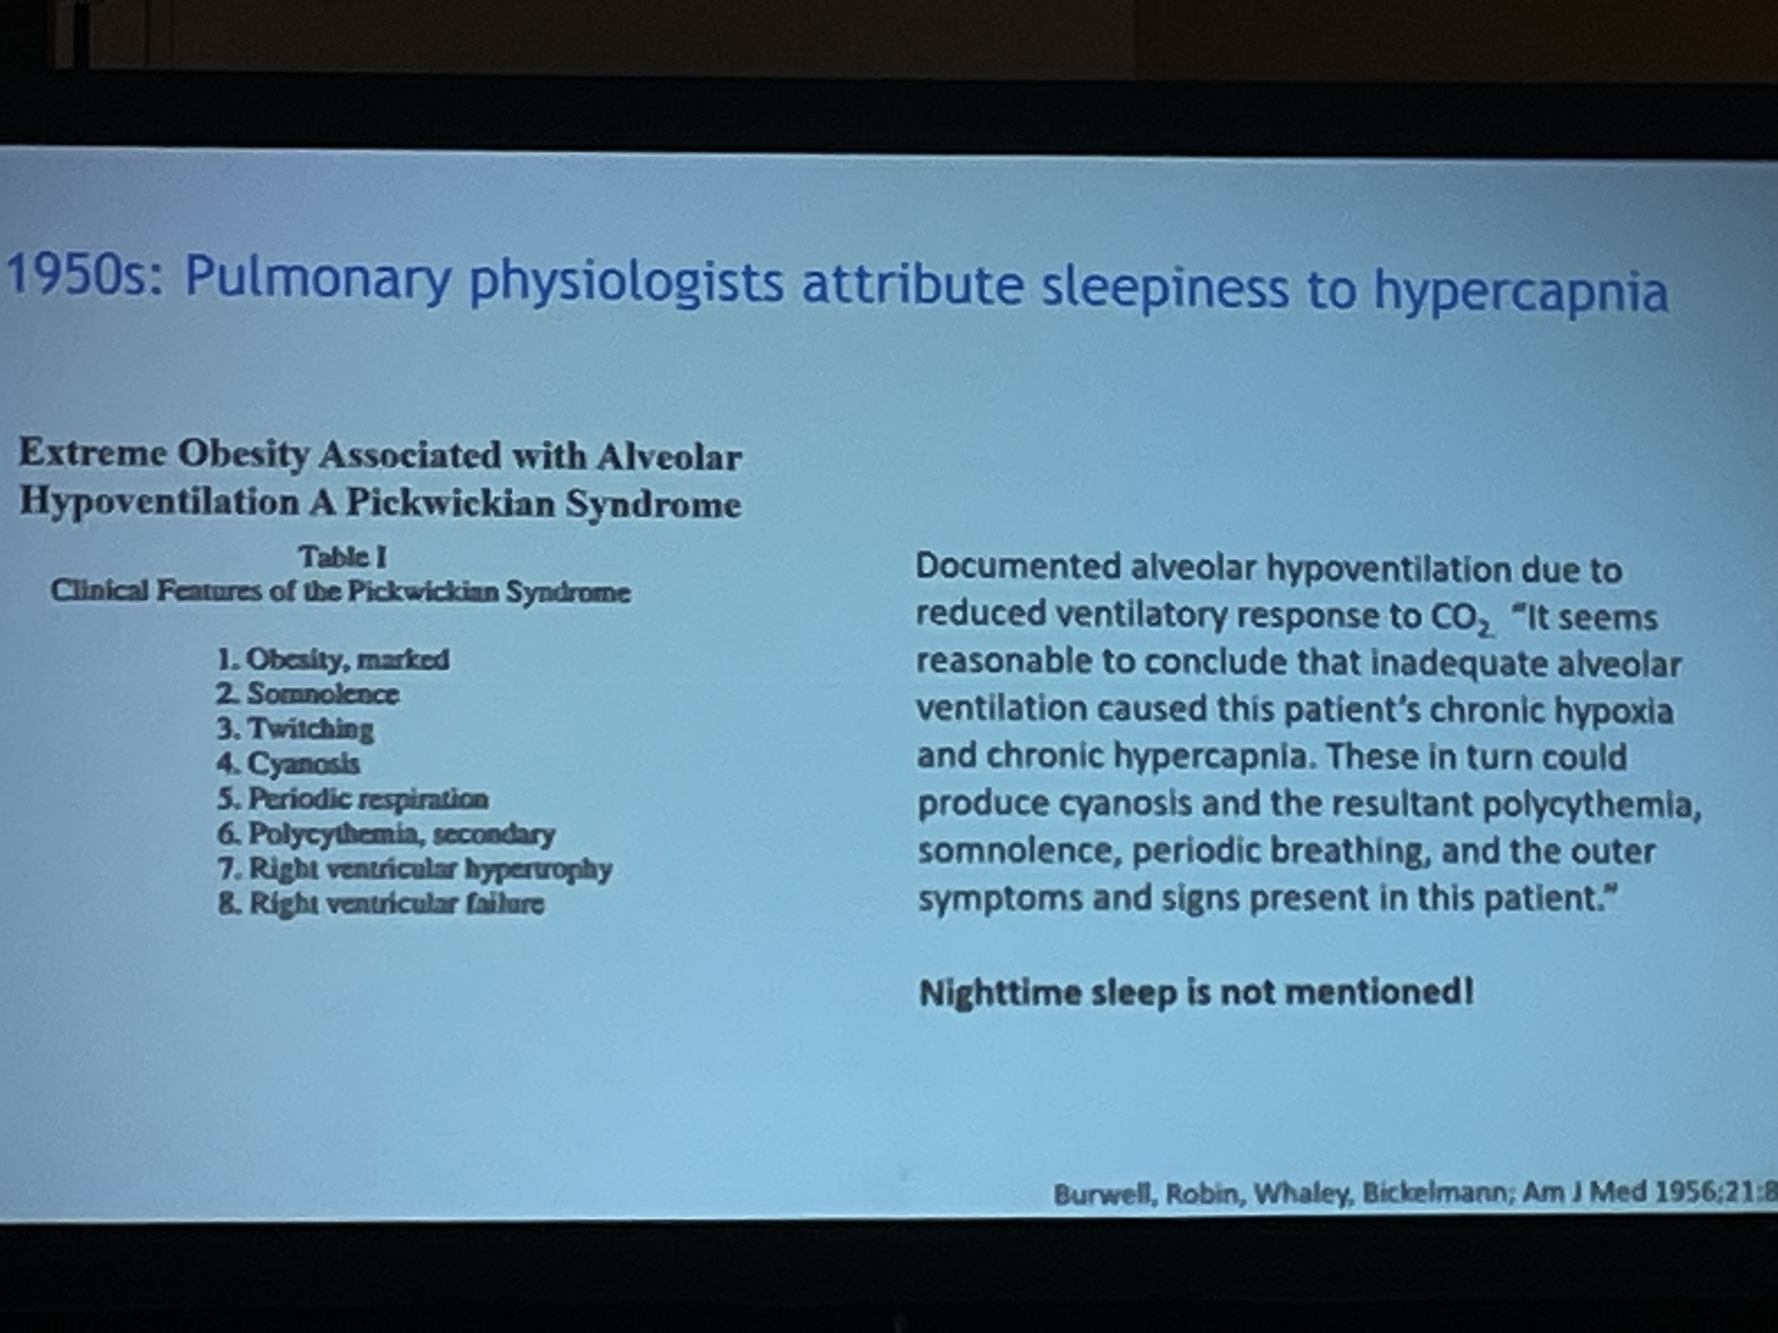
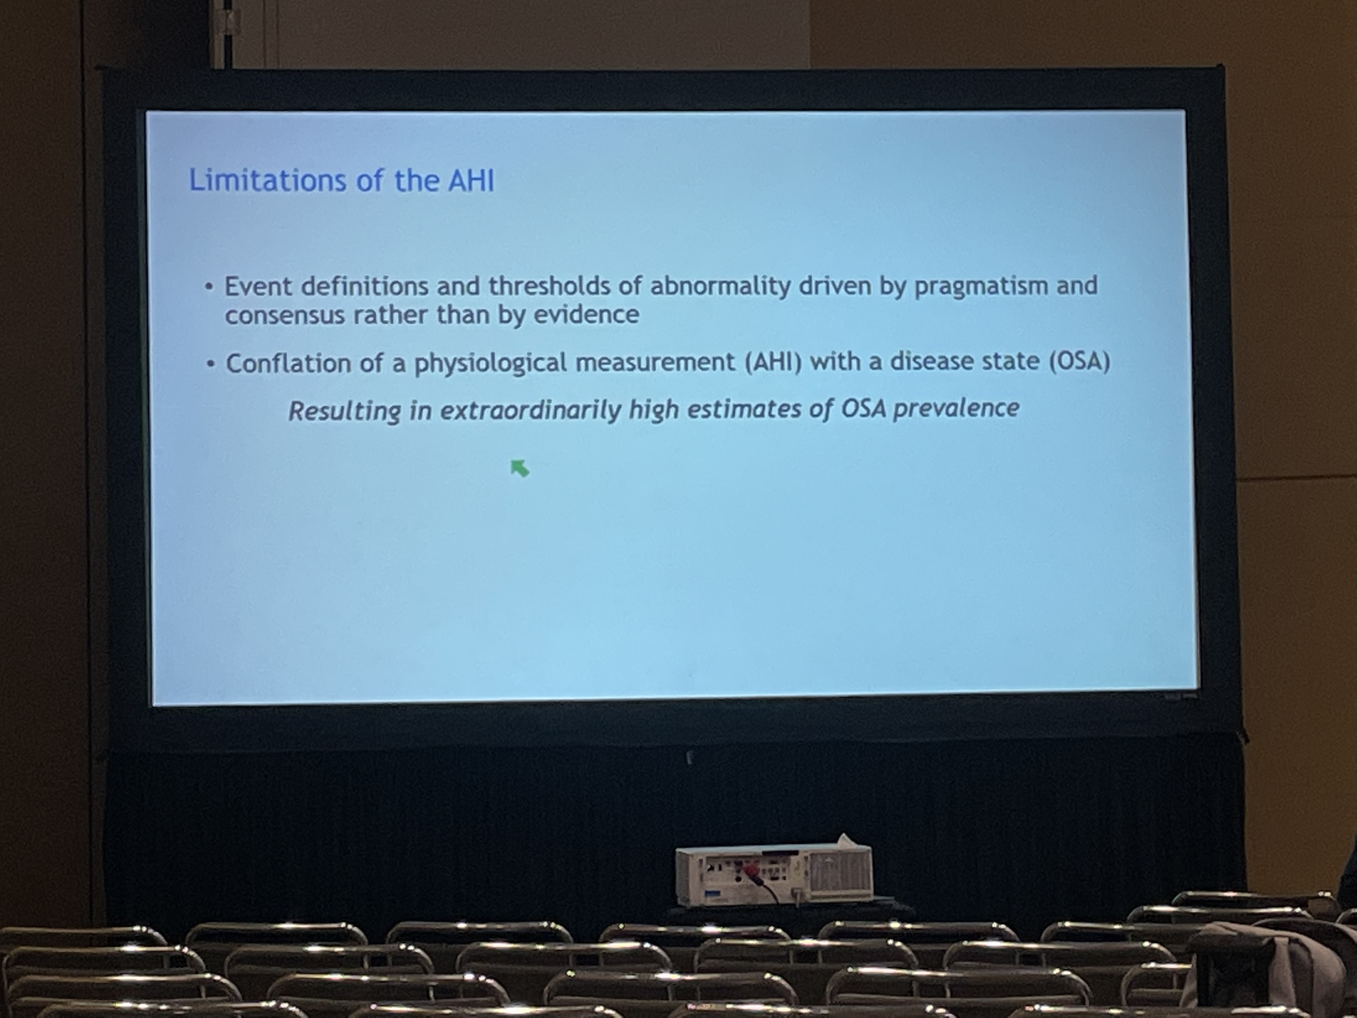
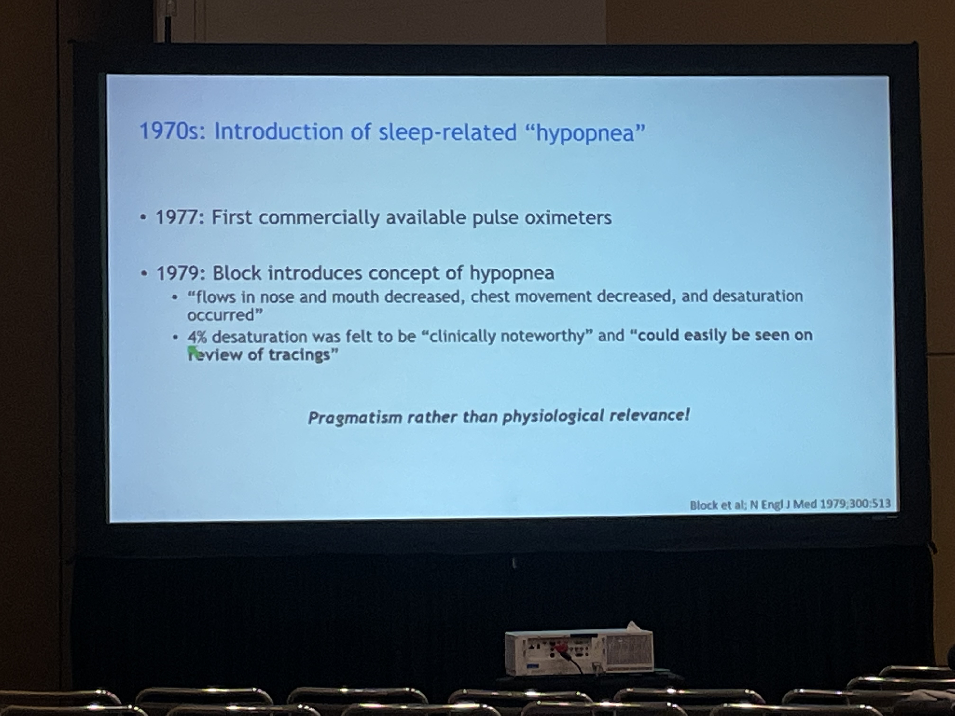
PROBLEMS WITH THE AHI
AHI as the defining metric of OSA: driven by pragmatism and consensus but not by evidence:
Physiologic measurement =/= Disease status
“1 billion people have OSA” = kinda bullshit

Slide 31
A 45-year-old man is seen in your clinic for severe obstructive sleep apnea and was recently started on continuous positive airway pressure (CPAP) after an in-laboratory titration demonstrated adequate control of disease on 12 cm of water pressure using an oronasal mask interface. He presents complaining that the mask is too cumbersome, and requests a change to a nasal interface.
Which of the following will be most likely after the patient is transitioned to this new interface?
He will require a higher CPAP pressure for adequate control of disease with a nasal mask.
His average adherence, as measured in hours per night, will increase.
He will have more air leak from the system.
His Epworth Sleepiness Scale (ESS) score will improve.
Notes:
Andrade RGS, Viana FM, Nascimento JA, et al. Nasal vs oronasal CPAP for OSA treatment: a meta-analysis. Chest. 2018;153(3):665-674. PubMed
Save
Deshpande S, Joosten S, Turton A, et al. Oronasal masks require a higher pressure than nasal and nasal pillow masks for the treatment of obstructive sleep apnea. J Clin Sleep Med. 2016;12(9):1263-1268. PubMed
Save
Rowland S, Aiyappan V, Hennessy C, et al. Comparing the efficacy, mask leak, patient adherence, and patient preference of three different CPAP interfaces to treat moderate-severe obstructive sleep apnea. J Clin Sleep Med. 2018;14(1):101-108. PubMed

Slide 32
A 45-year-old man is seen in your clinic for severe obstructive sleep apnea and was recently started on continuous positive airway pressure (CPAP) after an in-laboratory titration demonstrated adequate control of disease on 12 cm of water pressure using an oronasal mask interface. He presents complaining that the mask is too cumbersome, and requests a change to a nasal interface.
Which of the following will be most likely after the patient is transitioned to this new interface?
He will require a higher CPAP pressure for adequate control of disease with a nasal mask.
His average adherence, as measured in hours per night, will increase.
He will have more air leak from the system.
His Epworth Sleepiness Scale (ESS) score will improve.
Notes:
Andrade RGS, Viana FM, Nascimento JA, et al. Nasal vs oronasal CPAP for OSA treatment: a meta-analysis. Chest. 2018;153(3):665-674. PubMed
Save
Deshpande S, Joosten S, Turton A, et al. Oronasal masks require a higher pressure than nasal and nasal pillow masks for the treatment of obstructive sleep apnea. J Clin Sleep Med. 2016;12(9):1263-1268. PubMed
Save
Rowland S, Aiyappan V, Hennessy C, et al. Comparing the efficacy, mask leak, patient adherence, and patient preference of three different CPAP interfaces to treat moderate-severe obstructive sleep apnea. J Clin Sleep Med. 2018;14(1):101-108. PubMed

Slide 33
SEEK
A 56-year-old overweight woman with no medical history is referred to you for evaluation of OSA. She complains of loud disruptive snoring, excessive daytime sleepiness, and daytime fatigue. Her spouse is unwilling to sleep with her in the same room. Physical exam reveals a BMI of 28 kg/m². Her oropharynx is crowded. The remainder of the physical exam is normal. Recently, her primary care provider ordered a sleep study that demonstrated mild OSA, with an apnea-hypopnea index of 12 events per hour. Treatment with nasal CPAP was initiated, but the patient could not tolerate CPAP, despite multiple mask changes and CPAP device adjustments with an experienced respiratory therapist, as well as discussions with a primary care provider with educational interventions emphasizing the importance of CPAP adherence. She remains very interested in treatment but simply cannot tolerate having a mask on her face. In fact, she finds CPAP more disruptive to her sleep. What would you recommend?
Notes:
Multiple randomized clinical trials have shown that treatment of mild OSA improves daytime symptoms, quality of life, and the bed partner's quality of life. The patient is convinced she has OSA and remains very interested in treatment. An oral appliance designed to advance the mandible during sleep is an important therapeutic approach in patients with OSA, particularly in those with mild to moderate OSA. These devices can be used as a first-line treatment option, and it should definitely be considered in those who cannot tolerate CPAP therapy (choice A is correct). Despite multiple attempts, this patient continues to be CPAP intolerant. Therefore, insisting on using CPAP is unlikely to be helpful (choice B is incorrect). Randomized clinical trials have shown that in CPAP-naive patients, features related to the positive airway pressure (PAP) device itself (ie, auto-PAP vs fixed CPAP pressure, bilevel PAP vs CPAP, heated humidification vs no heated humidification, or expiratory pressure relief vs no expiratory pressure relief) does not lead to better CPAP adherence. However, this may not apply to patients who have a specific complaint about CPAP therapy. It is important to note that in a subset of patients, simple interventions such as finding a more comfortable mask interface or specific adjustments of the PAP device (eg, adjustment of heated humidification, expiratory pressure relief, or switching to bilevel PAP) can improve tolerance and lead to better adherence to PAP therapy. Moreover, randomized clinical trials have shown that motivational enhancement/cognitive behavioral therapy techniques and telemonitoring can improve CPAP adherence. However, in this patient, a variety of interfaces were tried to no avail, and her main complaint was not being willing to wear a mask on her face. Lastly, it is important to consider that in a small proportion of patients, CPAP can make them feel worse and be more disruptive to their sleep.

Slide 34
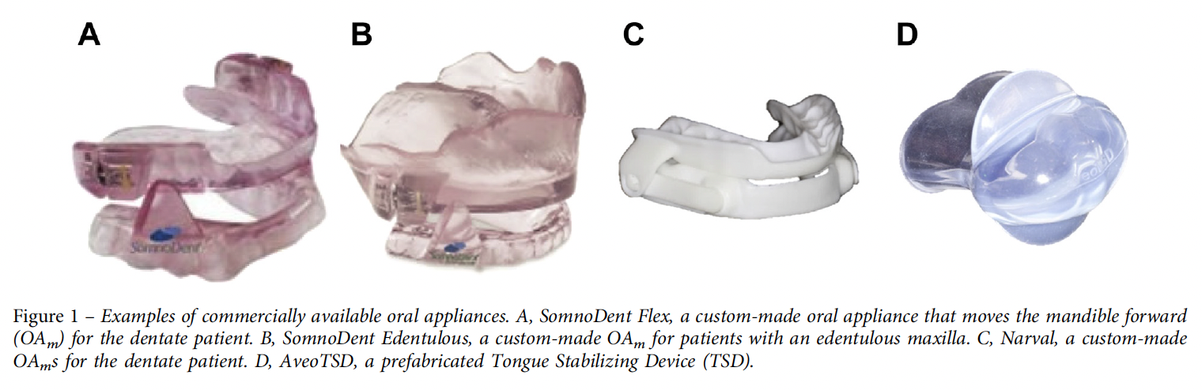
Oral Appliance Therapy
The American Academy of Sleep Medicine and the American Academy of Dental Sleep Medicine produced a joint updated guideline in 2015: used in adults who are intolerant of CPAP or express a preference for OAT
AHI reduction of CPAP is superior, but degree of BP reduction and improvement in sleepiness is similar (perhaps from greater use)
Notes:
From UTD:
Some studies suggest that complete resolution of OSA, defined as an AHI <5 events per hour during treatment, is more likely in patients with mild to moderate OSA (AHI 5 to 30 events per hour) than in patients with severe OSA (AHI >30 events per hour) [12]. However, this finding has not been universal [8,9].
The incomplete reduction of
AHI is partly counterbalanced by greater adherence and more regular nightly usage. Consequently, the
mean disease alleviation defined by the ratio of adherence to treatment over total sleep time divided by the
percentage of therapeutic efficacy is equivalent between CPAP and MADs [61, 62]. Indeed, overall,
MADs provide similar health outcomes to CPAP [63]. The equivalent efficacy of MAD and CPAP in
terms of mean disease alleviation is consistent with the results of a recent individual participant data
meta-analysis including seven randomised controlled trials. MADs had similar effectiveness to CPAP on
major patient-centred outcomes including sleepiness and quality of life [64].

Slide 35
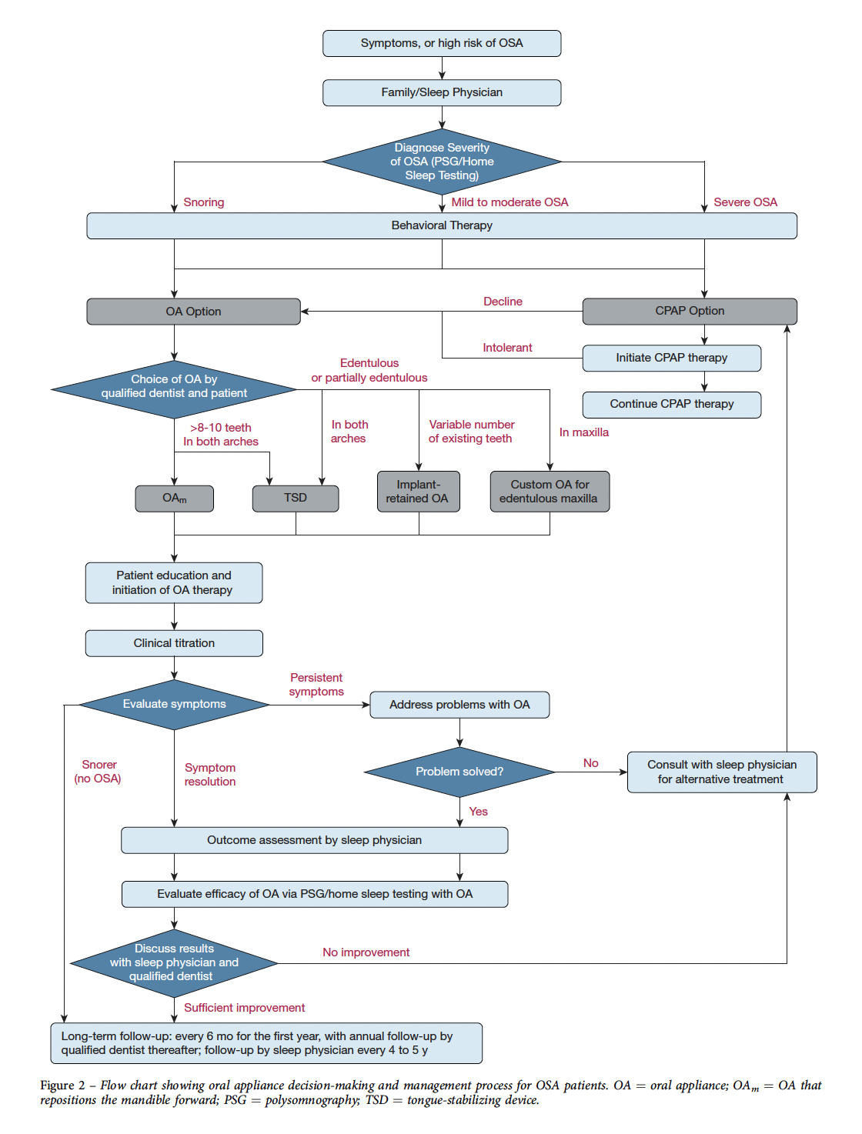
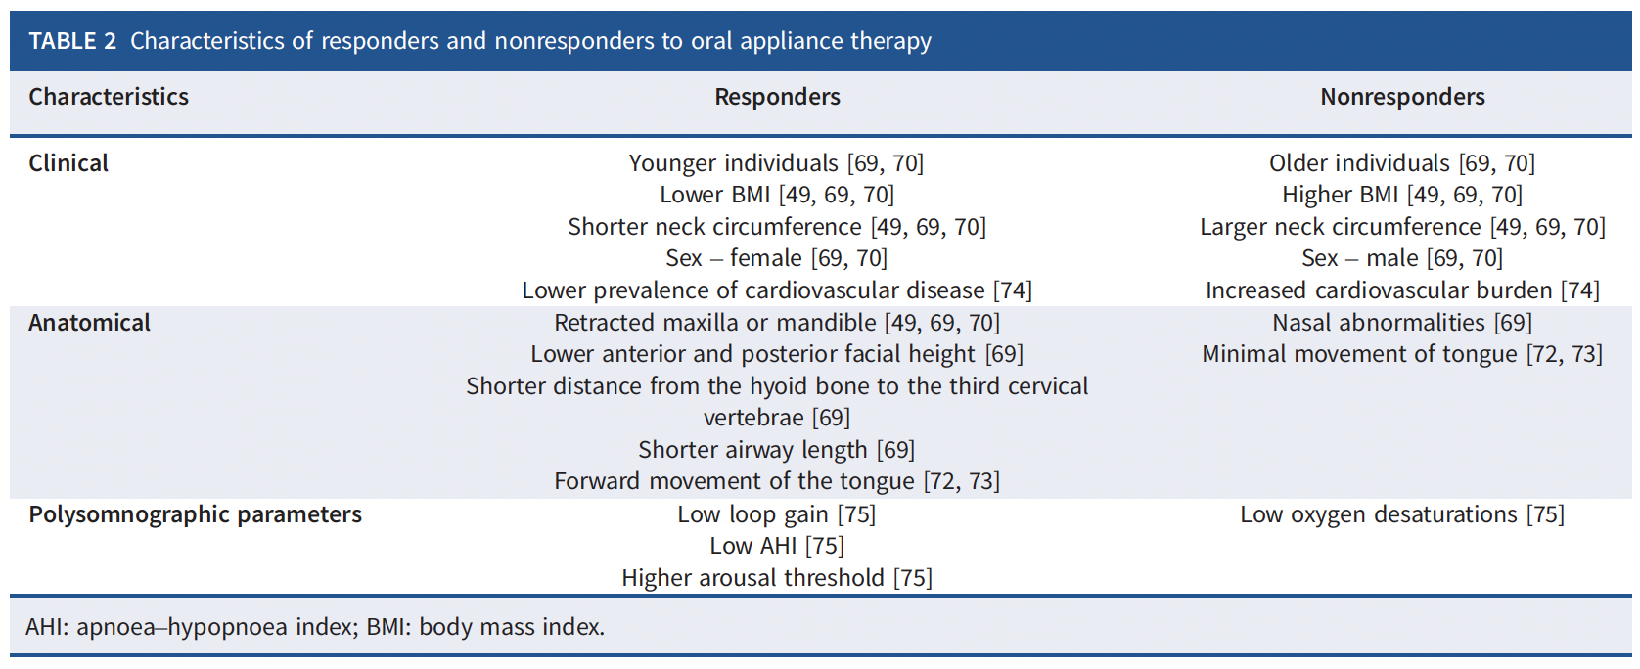

Slide 36
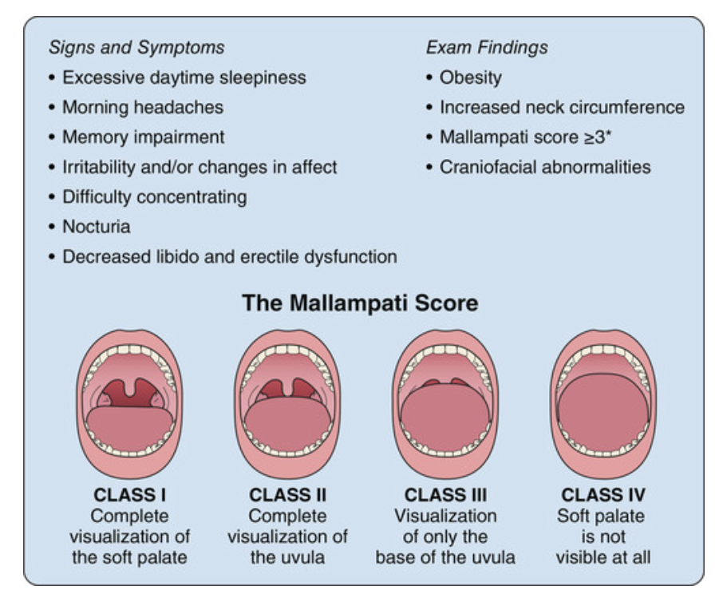
Don’t screen for OSA: USPSTF
DO NOT HAVE PATIENTS SAY ‘AHHH’ WHEN ASSESSING MALLAMPATI

Slide 37
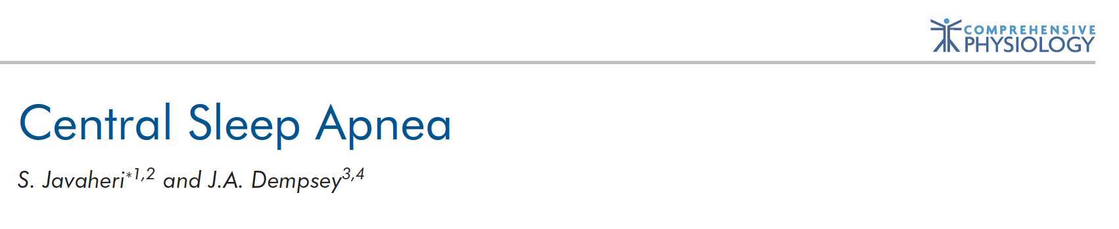
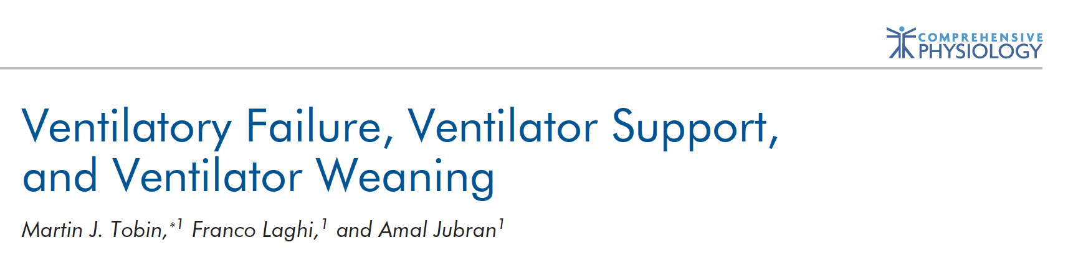
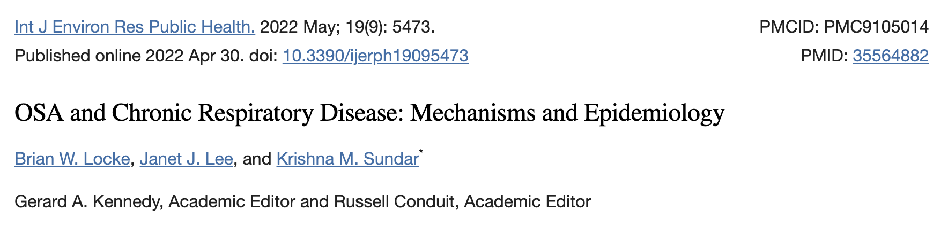
Additional References

Slide 38
Why is it so confusing to know what to do with OSA?
How could we possibly be designed to get so much sleep apnea?
https://www.sciencedirect.com/science/article/abs/pii/S138994570200237X?via%3Dihub

Slide 39
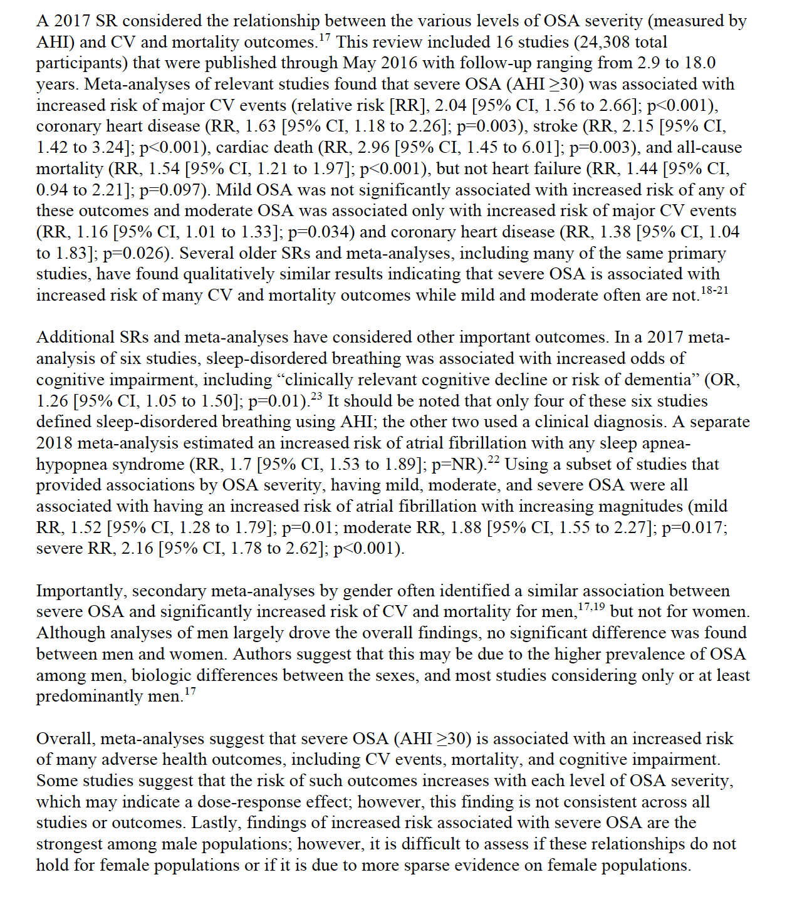
From JAMA SR

Slide 40
OSA pathophysiology
Notes:
a smaller,
more collapsible upper airway based on obesity
and airway anatomy; reduced upper airway dilator
muscle responsiveness; lower arousal threshold;
and increased sensitivity of the ventilatory control
system (loop gain)

Slide 41
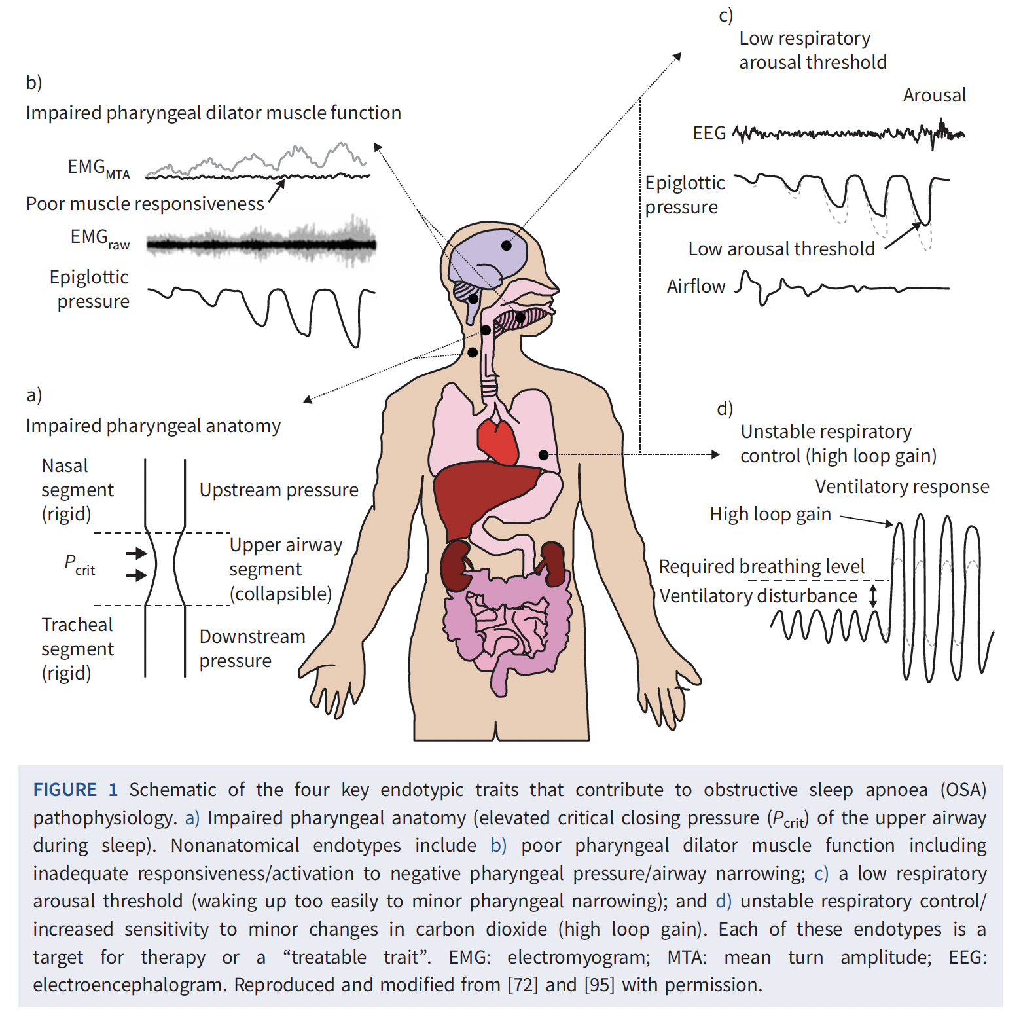
Notes:
Approximately 70% of people with OSA have one or more nonanatomical traits that contribute to their
OSA [6, 8]. These include impaired pharyngeal dilator muscle function during sleep, unstable respiratory
control (high loop gain) and waking up too easily to minor airway narrowing during sleep (low respiratory
arousal threshold)

Slide 42
When should you send a noc ox?
Probably pretty much never
——> talk about inpatient sleep testing.
Talk about the use of oxygen to treat sleep apnea etc. - it probably does actually have beneficial physiologic effects… but does this translate to meaningful benefits? probably not.
[NOTT]
(Presumably in the context of nocturnal hypoventilation: An Australian consensus statement recommends oxygen be entrained
when SpO2 is < 88% for 30% or more of the total sleep time.52
52: Agency for Clinical Innovation Respiratory Network. Domiciliary Non-Invasive Ventilation in Adult Patients: A Consensus Statement. Australia:
Agency for Clinical Innovation Respiratory Network; 2012.

Slide 43
What are the things that diagnosing+treating sleep apnea improves?
Talk about effectiveness of CPAP in improving different health outcomes
Reasons to treat OSA, from strongest support to most dubious
[note AHRQ report - https://www.ahrq.gov/sites/default/files/wysiwyg/research/findings/ta/sleep-apnea/sleep-apnea-report.pdf ]
Sleepiness
HRQOL
MVAs
HTN
preventing exacerbations of OHS
to prevent post-op complications in mod-severe disease
——
preventing exacerbations of COPD? Donovan
preventing CVAs
preventing heart attacks - https://jamanetwork.com/journals/jama/fullarticle/2810031 (note, with proper control, the role of sleepiness is
Preventing AFib
Notes:
AHA recommends:
We recommend screening for OSA in patients with resistant/poorly controlled hypertension, pulmonary hypertension, and recurrent atrial fibrillation after either cardioversion or ablation. In patients with New York Heart Association class II to IV heart failure and suspicion of sleep-disordered breathing or excessive daytime sleepiness, a formal sleep assessment is reasonable. In patients with tachy-brady syndrome or ventricular tachycardia or survivors of sudden cardiac death in whom sleep apnea is suspected after a comprehensive sleep assessment, evaluation for sleep apnea should be considered. After stroke, clinical equipoise exists with respect to screening and treatment.
Although OSA has been implicated as an independent risk factor for hypertension and resistant hypertension, effects of continuous positive airway pressure (CPAP) therapy on blood pressure (BP) lowering in hypertensive patients with OSA have been disappointing and inconsistent, with a meta-analysis showing reductions of BP of between 2 and 3 mm Hg.16 → note probably larger if resistant hypertension.

Slide 44
[ problems with trials; equipoise etc. ] - https://www.atsjournals.org/doi/full/10.1513/AnnalsATS.202303-258ST = fundamental problem for
— not very sleepy (if sleepiness is present, not ethical to withholds treatment) - however,
— not very much adherence.
——> ways to get at this: aggregate under-powered trials into a meta-analysis, enrich the population (e.g. try to perform post-hoc analyses (though things like healthy adherer bias are hard to
Note: if this is the explanation, it must be either an issue of power, or a qualitative interaction.

Slide 45
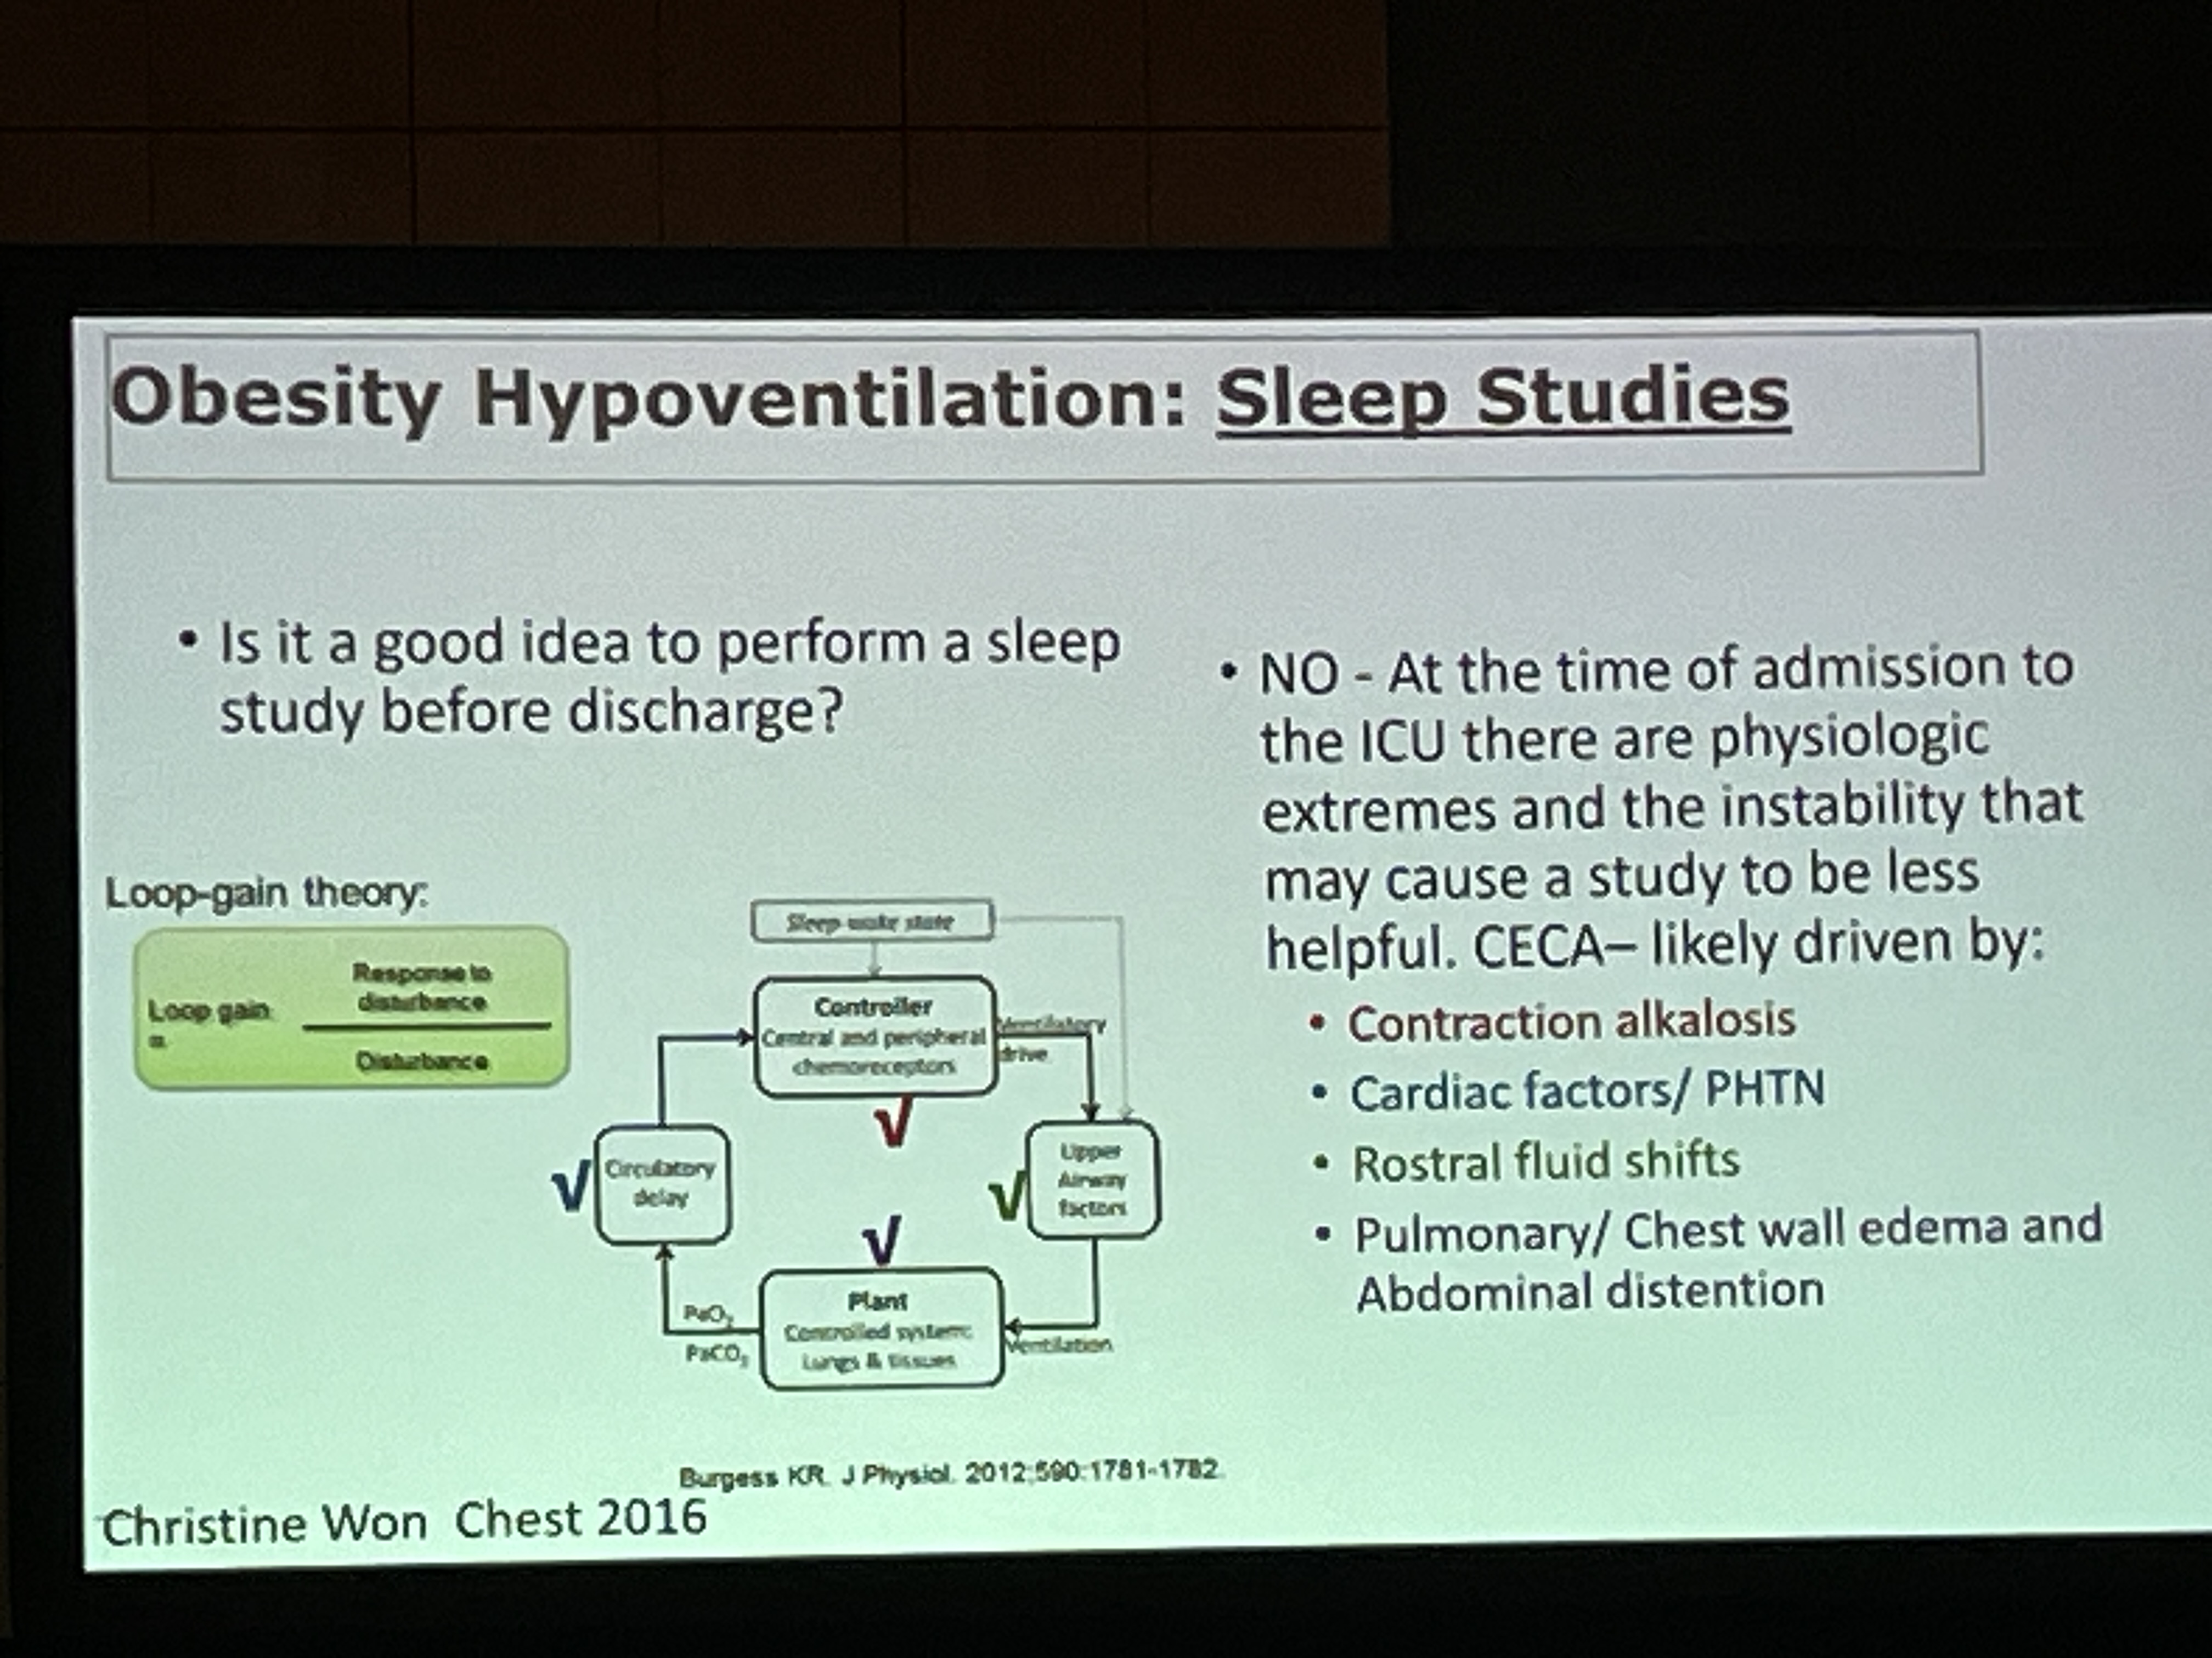
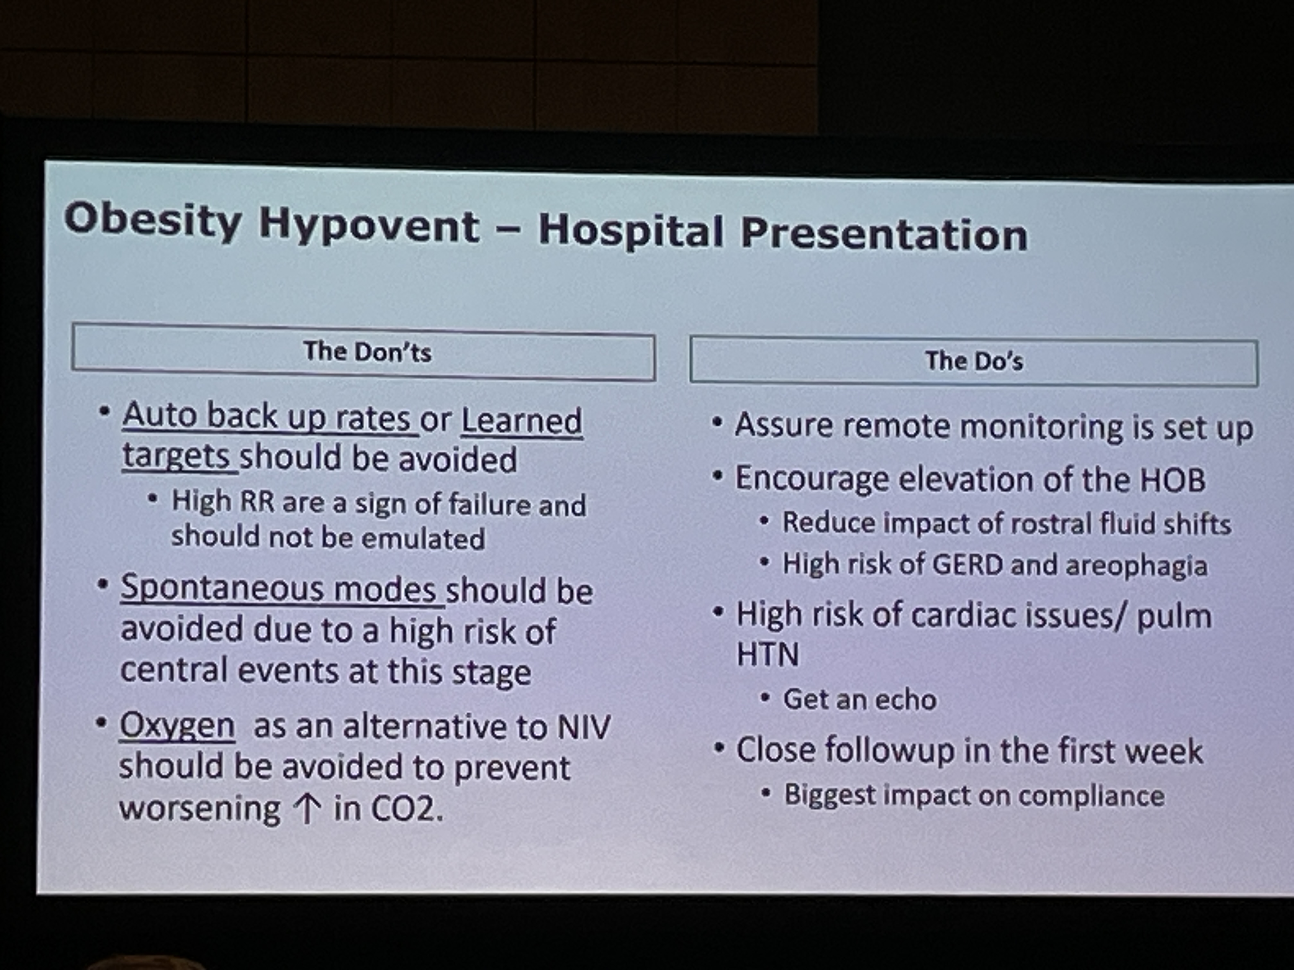
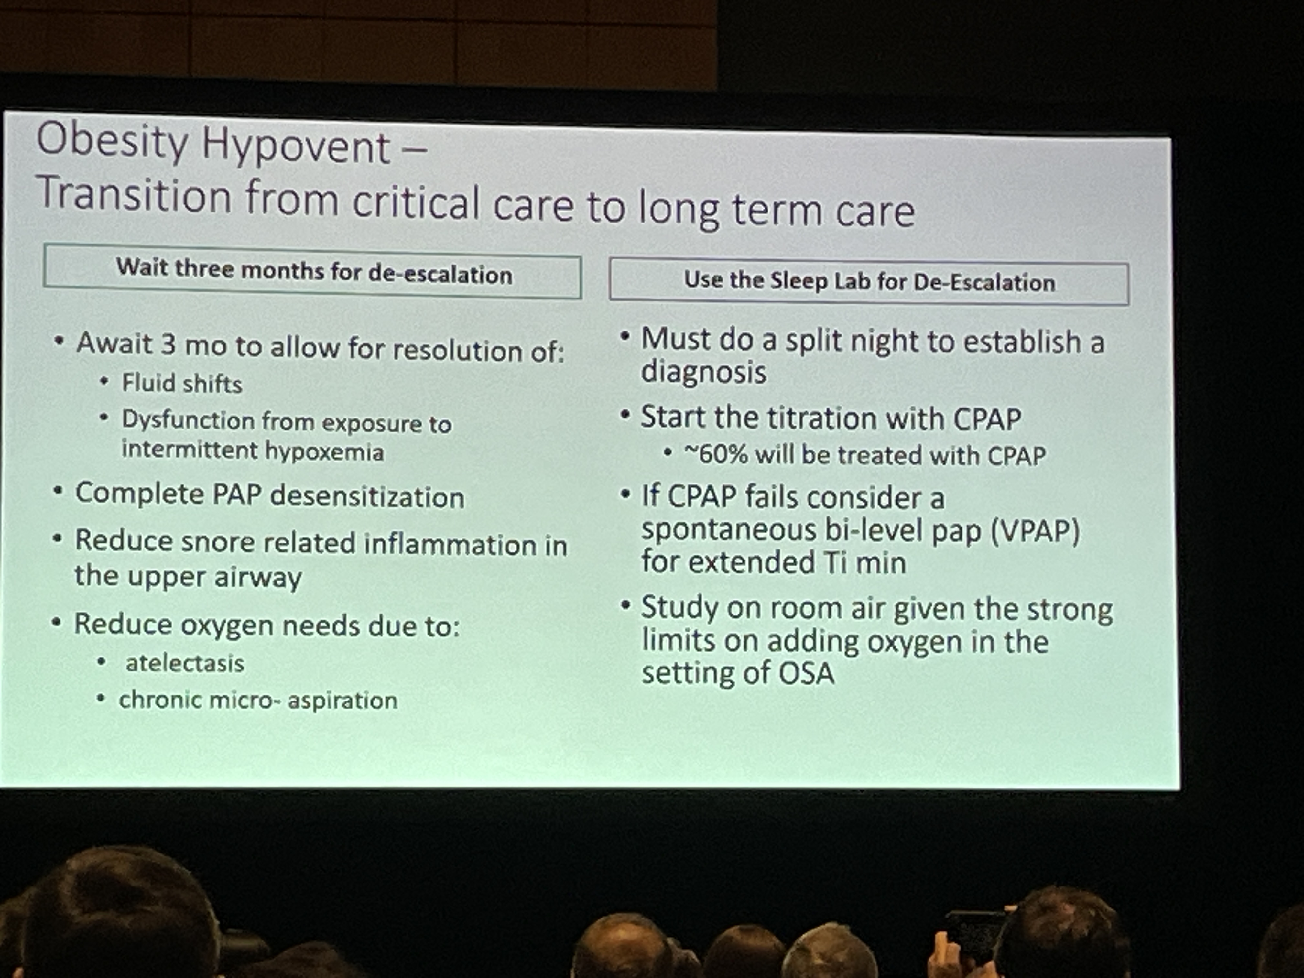
Who needs an inpatient sleep study?
Notes:
Consider VAPS-AE to adjust
Delay PSG for 3 months… then De-esc from HMV
-1500/mo for HMV E0464

Slide 46
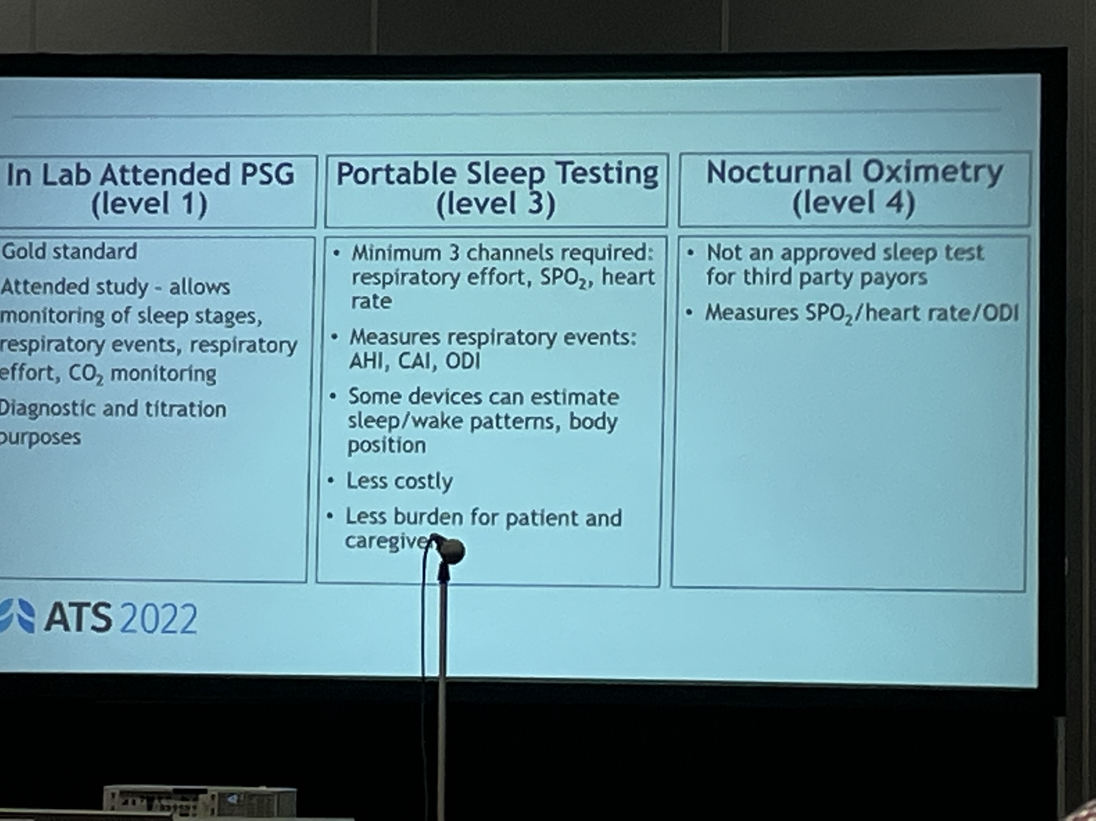

Slide 47
https://onlinelibrary.wiley.com/doi/full/10.1111/resp.12376
Hypoventilation occurs first during REM
But what to do with that?
Important for NMD.
Occurs in COPD/OHS , but the data is not there to say what we should do about it.
REM sleep neuromuscular control - > REM hypoventilation.
Sleep Hypoventilation very high prevalence in COPD
Notes:
Review of relevant physiology - For all patients, decreased drive to breathe, muscle paralysis occurs during REM sleep. - REM atonia of the voluntary, skeletal muscles.
Key Citation: https://onlinelibrary.wiley.com/doi/full/10.1111/resp.12376
the main reason for the particular vulnerability to hypoventilation during sleep is that sleep is associated with diminished ventilatory drive, particularly during rapid eye movement (REM) sleep
NREM: constant VE, mostly depends on central and peripheral chemoreceptors
REM: variable VE, reduced non-diaphragmatic muscle use
Of relevance: there is accumulating evidence of sleep deprivations effect on ventilatory control. Thus, some of the influence of sleep problems may not occur due to direct changes in ventilation, but indirect influence on ventilatory control due to sleep deprivation.

Slide 48
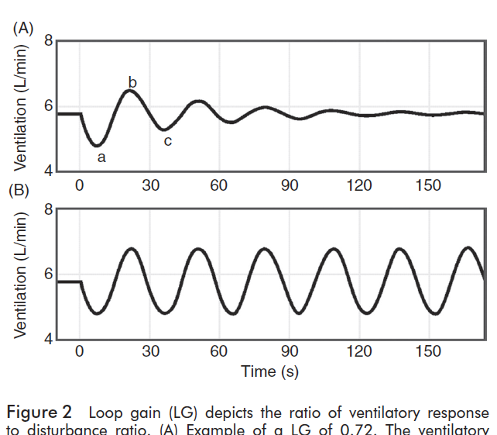
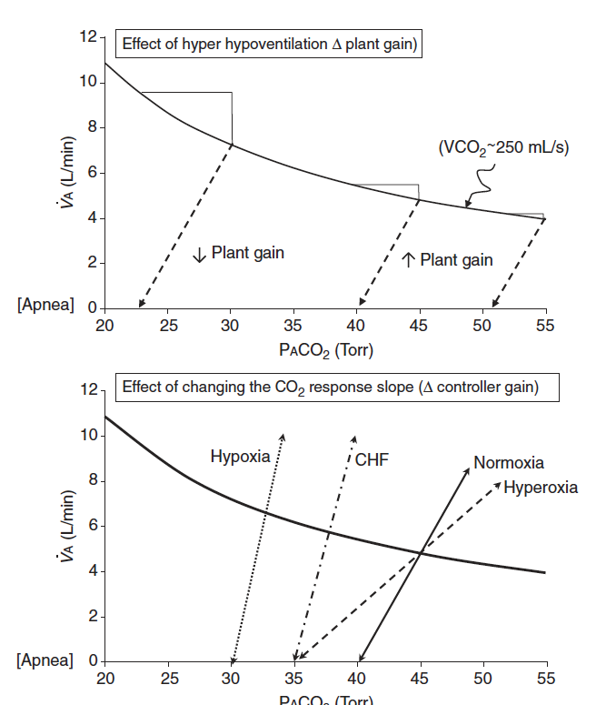
Does the PaCO2 ‘set-point’ change?
For example, in OHS:
Loop gain terminology primarily describes tendency toward stability of ventilation. ‘Gain’ of the feedback loop.
Controller gain: ventilatory response to PO2 and PCO2 )
Plant gain: changes in pulm capillary blood PO2 and PCO2 in response to changes in vent
Mixing gain: effective circulation time – time which cap blood changes are sensed by controller
Many changes are known to influence chemoreflex sensitivity
Ventillatory long-term facilitation is the process that should keep things on track
Ventilatory long-term facilitation is the term for adaptation to chronic stimulus (ie. sustained hypercapnia should increase loop gain to re-establish a baseline, and if this goes wrong you get a ‘wandering baseline’)
Notes:
Although ventilatory LTF has not been reported as such in OSA patients, when compared to age, sex and BMI matched non-OSA participants, untreated OSA patients exhibit a reduced P_{ET}CO₂, reduced CO₂ reserve and increased CO₂ sensitivity below eupnea, which reflects the expression of ventilatory LTF and ventilatory feedback (47, 55). Following CPAP treatment P_{ET}CO₂ and the CO₂ reserve increased in the OSA patients, further supporting the possible presence of ventilatory LTF in untreated OSA patients (47).
https://www.frontiersin.org/articles/10.3389/fneur.2018.00896/full
47 - Salloum A, Rowley JA, Mateika JH, Chowdhuri S, Omran Q, Badr MS. Increased propensity for central apnea in patients with obstructive sleep apnea: effect of nasal continuous positive airway pressure. Am J Respir Crit Care Med. (2010) 181:189–93. doi: 10.1164/rccm.200810-1658OC
55 - Chowdhuri S, Shanidze I, Pierchala L, Belen D, Mateika JH, Badr MS. Effect of episodic hypoxia on the susceptibility to hypocapnic central apnea during NREM sleep. J Appl Physiol. (2010) 108:369–77. doi: 10.1152/japplphysiol.00308.2009
Not clear that it really does ’reset’ so much as never able to compensate (by the modeling done in the next set of slides).
Perhaps this is different with Opiates, oxygen, etc.

Slide 49
https://pubmed.ncbi.nlm.nih.gov/31682462/ 196 – both CPAP and NIV improved pHTN and LV diastolic dsfxn similarly
OSA alone probably does not cause (much) pulmonary hypertension.
Remember – sustained hypoxemia is a well established risk for pulmonary hypertension, and preventing it is the primary reason we give patients LOT
https://jcsm.aasm.org/doi/abs/10.5664/jcsm.10286 perhaps sustained desat is the more relevant parameter?
OHS has more phtn https://pubmed.ncbi.nlm.nih.gov/25370507/
Notes:
Although the mechanism behind PH associated with OSA is not entirely understood, it is postulated to be due to a combination of factors including pulmonary arteriolar remodeling, susceptibility to hypoxia, and underlying left heart disease.⁷⁷³
A study of WHO group I PAH patients showed there was no significant difference in mortality in patients with and without OSA; however, mortality was significantly higher in patients with nocturnal hypoxemia, defined as an average SpO₂ < 90%, suggesting that duration and severity of nocturnal oxygen desaturation, well known to occur in OSA patients, is an important risk factor for development of PAH.⁷⁷⁶
two SRs reported that CPAP therapy is associated with a reduction in mPAP in patients with OSA and PH.^{772, 777} Another study showed that CPAP induced significant improvements in echocardiographic parameters, most notably pulmonary artery systolic pressure (PASP), further highlighting CPAP use and its positive effects on hemodynamic variables.⁷⁷¹
Individuals with OHS also spend a greater proportion of
sleep time and, in severe disease wakefulness, with SpO2
<90%. Periods of sustained hypoxemia are most likely to be
seen in REM sleep, and a significant relationship between the
amount of hypoventilation in REM sleep and CO2 sensitivity
has been shown (79

Slide 50
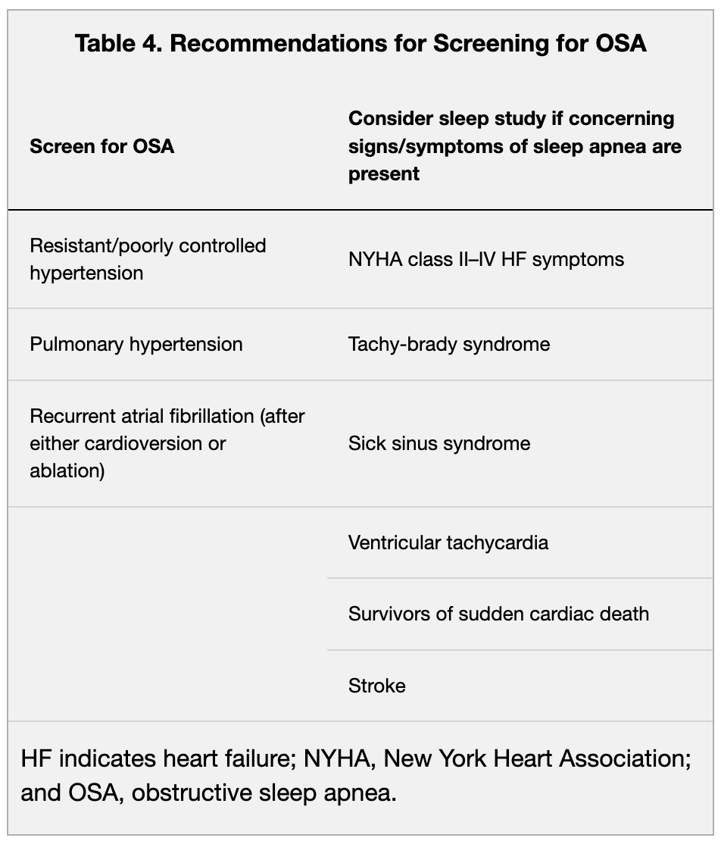
OSA and pulmonary hypertension
PH related to OSA is generally mild in the absence of additional cardiopulmonary disease, with average mean pulmonary artery pressure between 25 and 30 mm Hg and rarely exceeding 35 mm Hg
Separate out OHS?
Notes:
PH related to OSA is generally mild in the absence of additional cardiopulmonary disease, with average mean pulmonary artery pressure between 25 and 30 mm Hg and rarely exceeding 35 mm Hg.⁴³ In patients with severe PH attributable to another primary cause, coexisting OSA can exacerbate the disease process and increase mortality. In contrast to isolated OSA, patients with obesity hypoventilation syndrome, which is characterized by awake hypercapnia (Paco₂ >45 mm Hg) and obesity, commonly develop moderate to severe PH and higher risk of adverse outcomes, including cor pulmonale and death.⁴⁵
The available literature is limited by size and study design but suggests potential benefit associated with treatment of PH with CPAP. Observational studies have found consistent yet modest reductions in pulmonary artery pressure (≈5 mm Hg) and pulmonary vascular resistance among PH patients receiving CPAP therapy.⁴⁴
43.Kholdani C, Fares WH, Mohsenin V. Pulmonary hypertension in obstructive sleep apnea: is it clinically significant? A critical analysis of the association and pathophysiology.Pulm Circ. 2015; 5:220–227. doi: 10.1086/679995CrossrefMedlineGoogle Scholar
44.Sajkov D, Wang T, Saunders NA, Bune AJ, Mcevoy RD. Continuous positive airway pressure treatment improves pulmonary hemodynamics in patients with obstructive sleep apnea.Am J Respir Crit Care Med. 2002; 165:152–158. doi: 10.1164/ajrccm.165.2.2010092CrossrefMedlineGoogle Scholar
45.Masa JF, Pépin JL, Borel JC, Mokhlesi B, Murphy PB, Sánchez-Quiroga M. Obesity hypoventilation syndrome.Eur Respir Rev. 2019; 28:180097. doi: 10.1183/16000617.0097-2018CrossrefMedlineGoogle Scholar
https://www.ahajournals.org/doi/full/10.1161/CIR.0000000000000988?rfr_dat=cr_pub++0pubmed&url_ver=Z39.88-2003&rfr_id=ori%3Arid%3Acrossref.org
Recommendation:
“We suggest also that contributing causes of PH (eg, sleep apnea and systemic hypertension) in patients with PAH be treated aggressively (Ungraded consensus-based statement).”
Consider, does increasing the lung volume in general lower pulmonary pressure? Possibly.

Slide 51
Does OSA increase cardiovascular risk?
They are definitely assocated
Burden of hypoxemia meiates CV? data reviewed here
https://www.atsjournals.org/doi/epdf/10.1164/rccm.202307-1243ED?role=tab
Sleepy subtype?

Slide 52
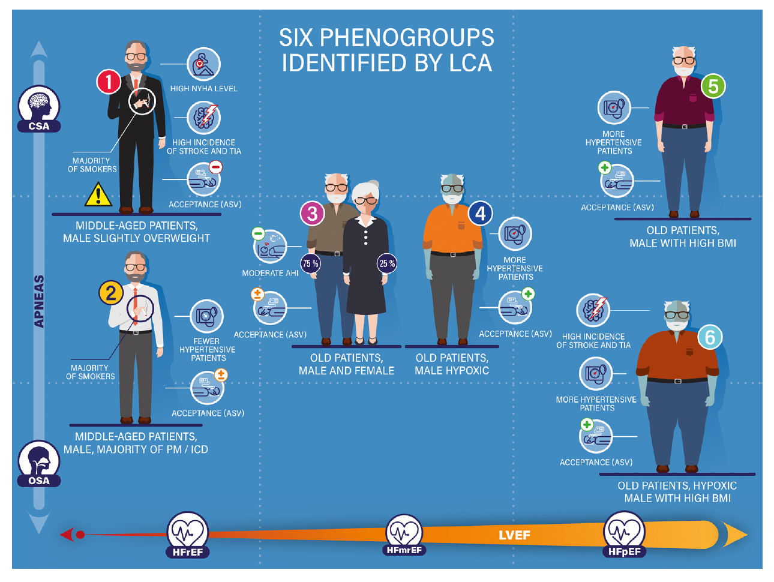
Lots of SDB in heart failure
CSA -> ASV?
HfPEF & SDB = historical estimates, 37-58% [probably even higher in UT]; Artz et al ESC Heart Failure 2022 https://pubmed.ncbi.nlm.nih.gov/36052740/
n= 3289 patients, used a threshold of AHI > 15. HSAT (not able to differentiate hypopnea)
Low prevalence in HFpEF vs HFrEF
Higher prevalence in Men.
Has [ ] good figure of OSA vs CSA
Agrawal AnnalsATS 2023 - https://pubmed.ncbi.nlm.nih.gov/36375082/
n= 2961
People w/ and w/o failure with CSA have higher mortality than OSA.
—> particularly look for patients with low BMI
Explain ventilation control:
Controller Gain = chemoresponsiveness
Plant gain = amount of ventilation needed to reach the apnea threshold.
FACE HF
SERVE-HF = increased CV mortality with ASV CAT-HF JACC 2017 = subgroup with HFpEF benefitS? [ ] look into that
ADVENT-HF = neutral

Slide 53
Adherence
To be eligible for
long-termcoverage, CMSmandates that
beneficiaries use PAP 4 or more hours per
day for 70% of days over a continuous
30-day period within the first 90 days of
receiving the device (37). These rules have
been widely adopted by other large insurance
carriers across the United States without any
validity testing.
Notes:
The CMS coverage determination 4-hour
rule was instituted in 2008 and quickly
became the standard measure of adherence
asmost commercial payers subsequently
adopted it (41). In contrast, the Department
of Veterans Affairs, another U.S. government
entity, does not use this determination and
instead explicitly provides the rationale that
even low hourly PAP usemay benefit
patients

Slide 54
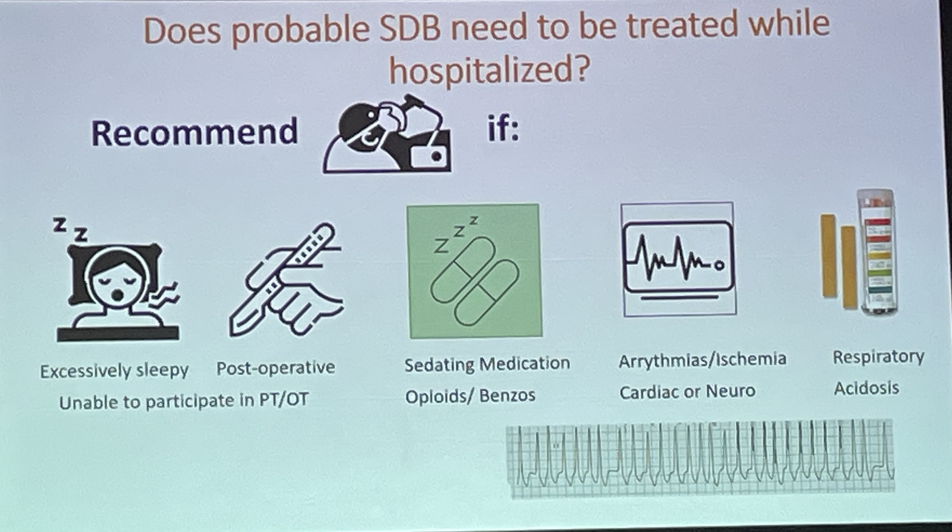

Slide 55
Reasons not to get a Sleep study (analogous to why not to get a TTE while most congested)
Notes:
Why not just run HSAT sleep studies on everyone?
You can only bill the professional interpretation code, none of the time for setup, facitlies etc.
If they are on oxygen, it will make it so that you won’t see any desaturation hypoxemias.
Realistically, their physiology is probably all f’d up.

Slide 56
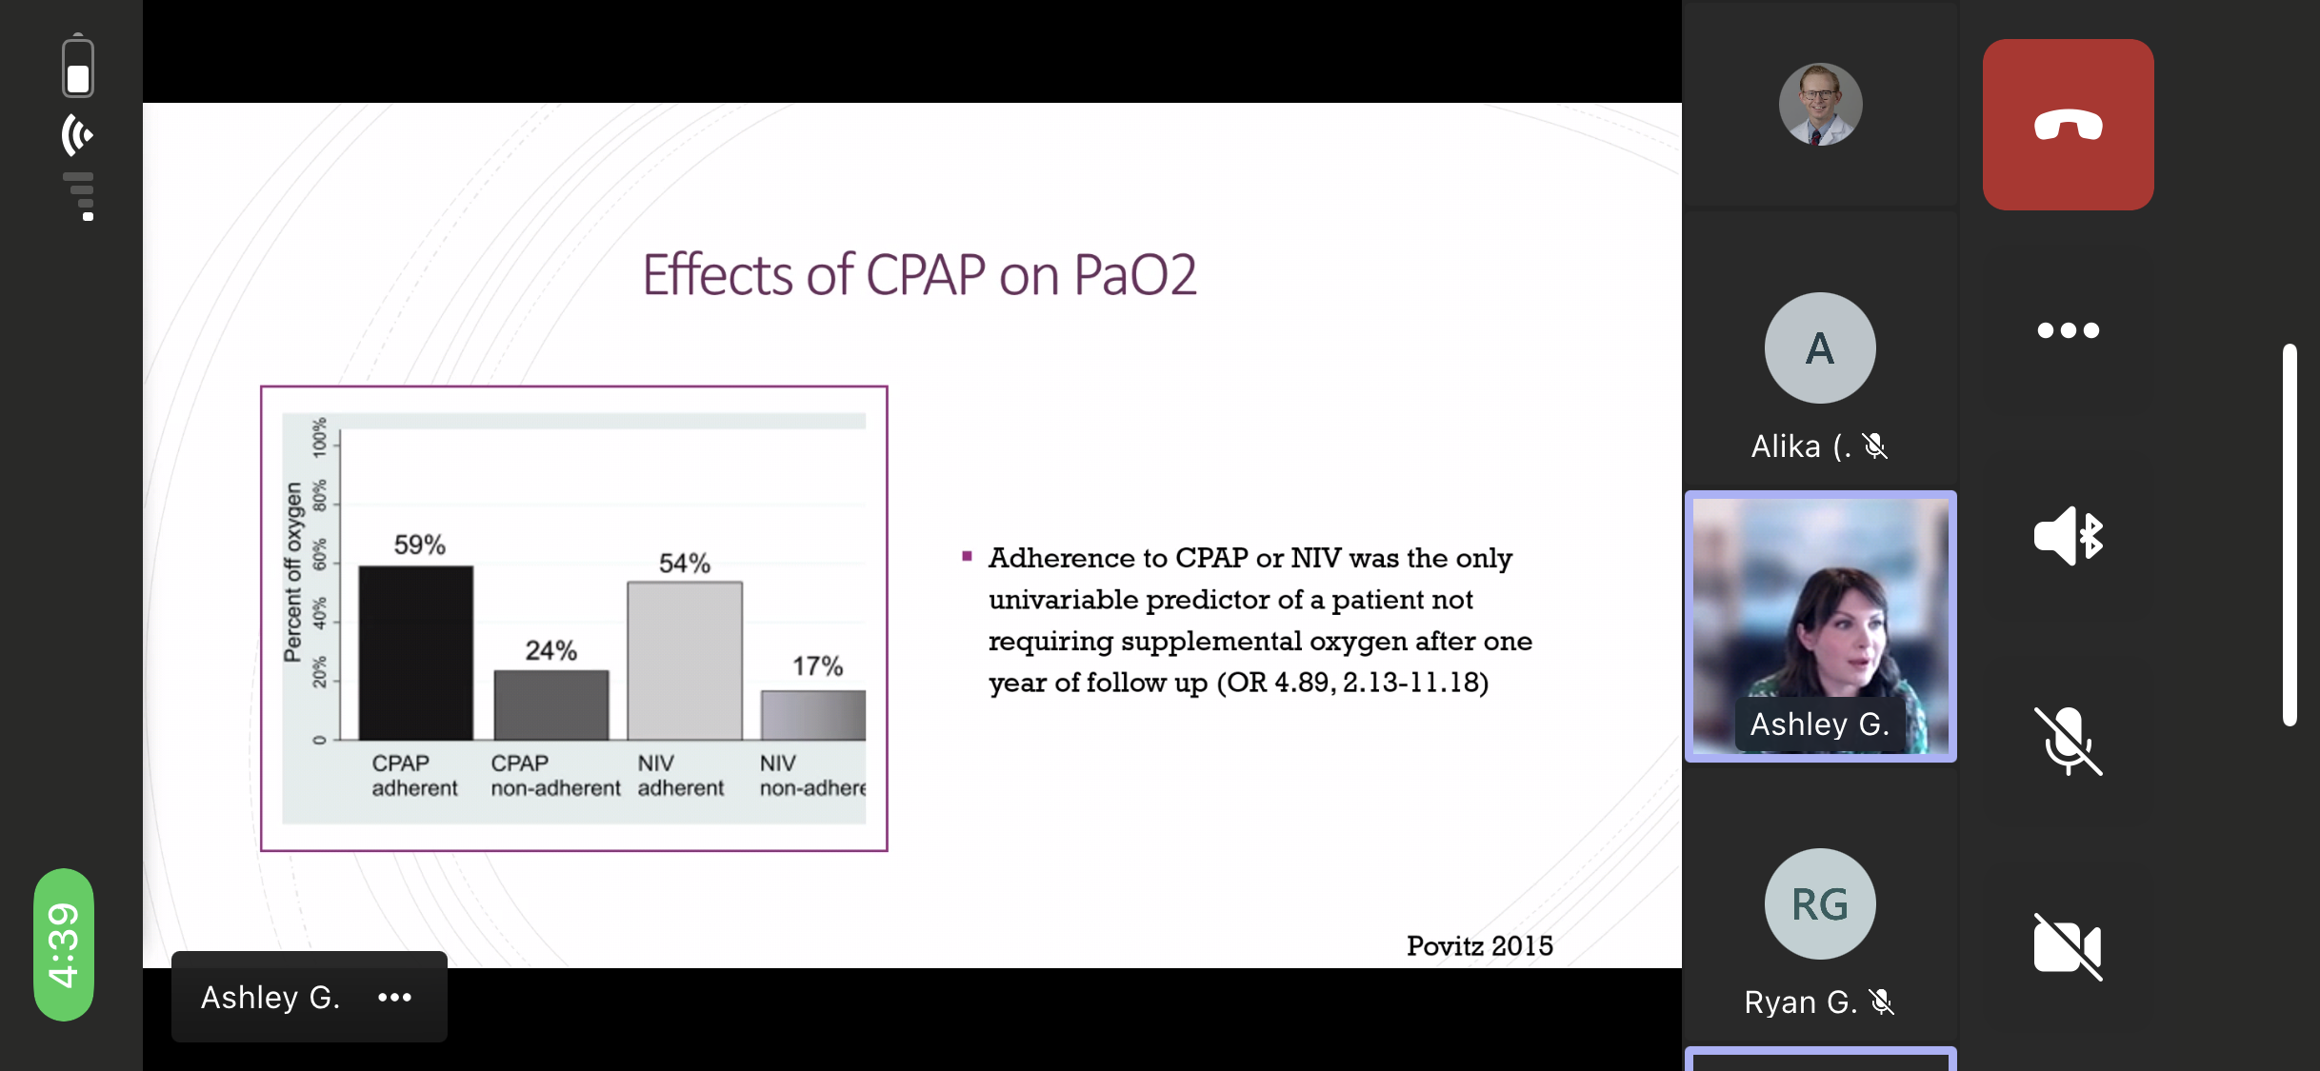

Slide 57
Chest 2021 Noct o2 rev - DOI: https://doi.org/10.1016/j.chest.2021.02.017
29-66 % of patients with COPD have OSA 37-41
Conflicting results about O2 effect OSA generally – no direct evidence to overlap
O2 therapy doesn’t seem to increase risk of hypercapnia - NSO therapy at 2 L/min reduced the episodes of desaturation per hour and the time spent in desaturation, but there were no differences between air and oxygen in episodes of SDB per hour, the duration of episodes of SDB, baseline sleeping PaCO2 , or PaCO2 during episodes of desaturation or SDB (https://www.sciencedirect.com/science/article/abs/pii/S0012369216310984) , 44. (Goldstein RS, Ramcharan V, Bowes G, McNicholas WT, Bradley D, Phillipson EA. Effect of supplemental nocturnal oxygen on gas exchange in patients with severe obstructive lung disease. N Engl J Med. 1984;310(7):425-429.)
In one study, elevated venous bicarbonate, a surrogate of hypercapnia, was noted in patients with OSA (not just overlap) receiving NSO - https://www.atsjournals.org/doi/10.1164/rccm.201802-0240OC
Notes:
Furthermore, hypercapnia alone can induce sympathetic activation and BP elevations.46,47
46. https://www.tandfonline.com/doi/abs/10.3109/10641968809075998 – general physiology
47. https://erj.ersjournals.com/content/35/1/132 – specifically in OSA-COPD overlap
37-41
37 37. Lopez-Acevedo MN, Torres-Palacios A, Elena Ocasio-Tascon M, Campos-Santiago Z, Rodriguez-Cintron W. Overlap syndrome: anindication for sleep studies?: a pilot study. Sleep Breath. 2009;13(4): 409-413. chestjournal.
38 38. Soler X, Gaio E, Powell FL, et al. High prevalence of obstructive sleep apnea in patients with moderate to severe chronic obstructive pulmonary disease. Ann Am Thorac Soc. 2015;12(8):1219-1225.
39. 39. Sanders MH, Newman AB, Haggerty CL, et al. Sleep and sleepdisordered breathing in adults with predominantly mild obstructive airway disease. Am J Respir Crit Care Med. 2003;167(1):7-14.
40 40. Owens RL, Malhotra A. Sleep-disordered breathing and COPD: the overlap syndrome. Respir Care. 2010;55(10):1333-1344; discussion 1344-1336.
41. 41. Marin JM, Soriano JB, Carrizo SJ, Boldova A, Celli BR. Outcomes in patients with chronic obstructive pulmonary disease and
obstructive sleep apnea: the overlap syndrome. Am J Respir Crit Care Med. 2010;182(3):325-331.

Slide 58
Should you get a nocturnal oximetry to diagnose overlap syndrome in your patient with COPD? No https://pubmed.ncbi.nlm.nih.gov/31995805/

Slide 59
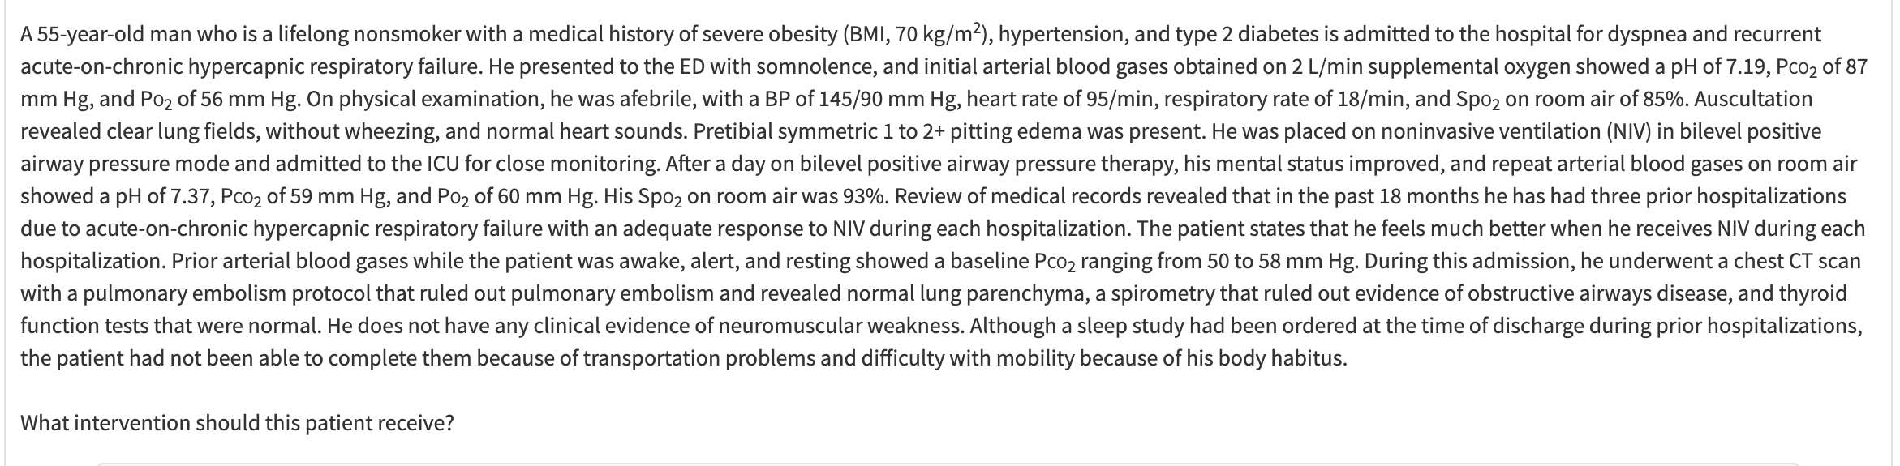

Slide 60
Does O2 treat OSA? Yes and No
Yes: post-operative, and at elevation
No: we don’t know if that has any meaningful impact on anything important, and O2 is actually probably more expensive, even if better tolerated.

Slide 61
CPAP and OSA
https://journals.lww.com/cardiologyinreview/abstract/9900/effect_of_continuous_positive_airway_pressure.108.aspx
https://www.ncbi.nlm.nih.gov/pmc/articles/PMC7642642/

Slide 62
Is unexplained exertional intolerance a reason to look for OSA?
https://doi.org/10.1016/j.chest.2022.09.027
I think, not entirely clear?

Slide 63
VCO2
even when at rest the cellular production of CO2 is
prodigious, approximating 10 mmol/min and yielding aVCO2
of about 0.2 liter/min for a fit 70 kg person. Any reduction in
the ability of the respiratory system to eliminate CO2 at the
lungs results in rapid acidification of the blood and tissues.
The situation becomes more profound with exercise. VCO2
can increase 30-fold with high-intensity exercise, reflecting
both the high rate of skeletal muscle CO2 production and acid
titration of CO2 stores.
Notes:
“VCO2 can increase 30-fold with high-intensity exercise”
Forster, H.V., Haouzi, P., and Dempsey, J.A. (2012). Control of breathing during exercise. Compr. Physiol. 2, 743–777.

